Slide 1
PADAS
Innovating Clinical Assessment Management: Simplifying Creation and Dissemination of Psychological Assessments
CSC 450 - Software Engineering, Fall 2023
Project Manager, Lead Developer: Luis Kellermann
Developers: Eric Foreman, Rachel Keiter, Michael Totaro, Hannah Vuncannon

Slide 2
Purpose
PADAS stands for the Psychological Assessment Distribution and Analysis System.
Our software application acts as a bridge which closes the gap between the way clinical assessments are created, distributed, and taken.
The goal is to make customized psychological assessments more efficient to create, distribute, and access.
PADAS breaks away from traditional paper-based assessment methods, offering a digital, customizable, and interactive experience.

Slide 3
Users
Assessment Builder
Clinician
Patients
Traditional methods of assessment creation are often cumbersome, time-consuming, and lack flexibility.
PADAS provides an intuitive user-friendly interface for creating custom tailored assessments.
Enables assessment builders to craft tailored assessments that accurately measure patient needs and responses
Obtaining and managing a wide array of custom assessments efficiently can be a troubling task.
PADAS streamlines the distribution of assessments to clinicians.
Clinicians can search from a library of custom-tailored assessments to easily assign, track, and administer assessments to patients.
Patients often find traditional assessment methods less interactive, leading to lower engagement and response accuracy.
Our system offers an engaging and user-friendly interface for patients to complete assessments.
Assessments contain various interaction types, making the overall process more accessible and engaging

Slide 4
Users (cont.) - Flow Between Users
Login opt. 1
Login opt. 2
Assessment Builder
Clinician
Patient
Creates custom assessment
Selects assessment from library
Takes the assigned assessment
Uploads assessment to library
Selects a patient under their care
Assigns the assessment to the patient

Slide 5
Technologies Used
Front-End
Back-End
Database
Vue.js
Vuetify
Vue Router
Pinia
Vite
Tailwind CSS
Axios
HTTP client for API requests
Flask
Lightweight Python Micro web framework
SQLAlchemy
ORM for Python
Access and manage SQL database using Python
Marshmallow
Serializing/Deserializing objects
Pytest & Coverage
Zappa
Serverless python deployment automation/Config. tool
PostgreSQL
RDBMS, chosen for its ability to store and query raw JSON objects and relational nature of our data

Slide 6
System Architecture (Serverless Web Application)

Slide 7
Demonstration
PADAS

Slide 8
Technical Challenge
System Design/Integrating Diverse Technologies
This challenge was not just about of using new technologies, but effectively combining them to create a cohesive and maintanable system.
Designing the system to ensure seamless communication and efficient data flow between components.
ETC: Easier-to-Change
Don't trade off flexiblity to for short-term solutions
Need to adapt based on implementation discoveries

Slide 9
Message to Prior Selves
Get universal UI elements set early on so that things are developed with these already implemented
Have a good foundation and plan on coding in the long-term and not just the short-term.
Don't slack on learning new material for the project!
Make sure to dedicate enough time to properly learning any new systems, formats, languages etc., you will need to for your project if you know you will be using new ones!'
Get a head start and don't shy away from delving into documentation and tutorials early on
Embrace Felxiblity and Continuous learning
The diversity of technologies and application architecture will require you to adapt and learn rapidly.

Slide 10
Questions?

Slide 11
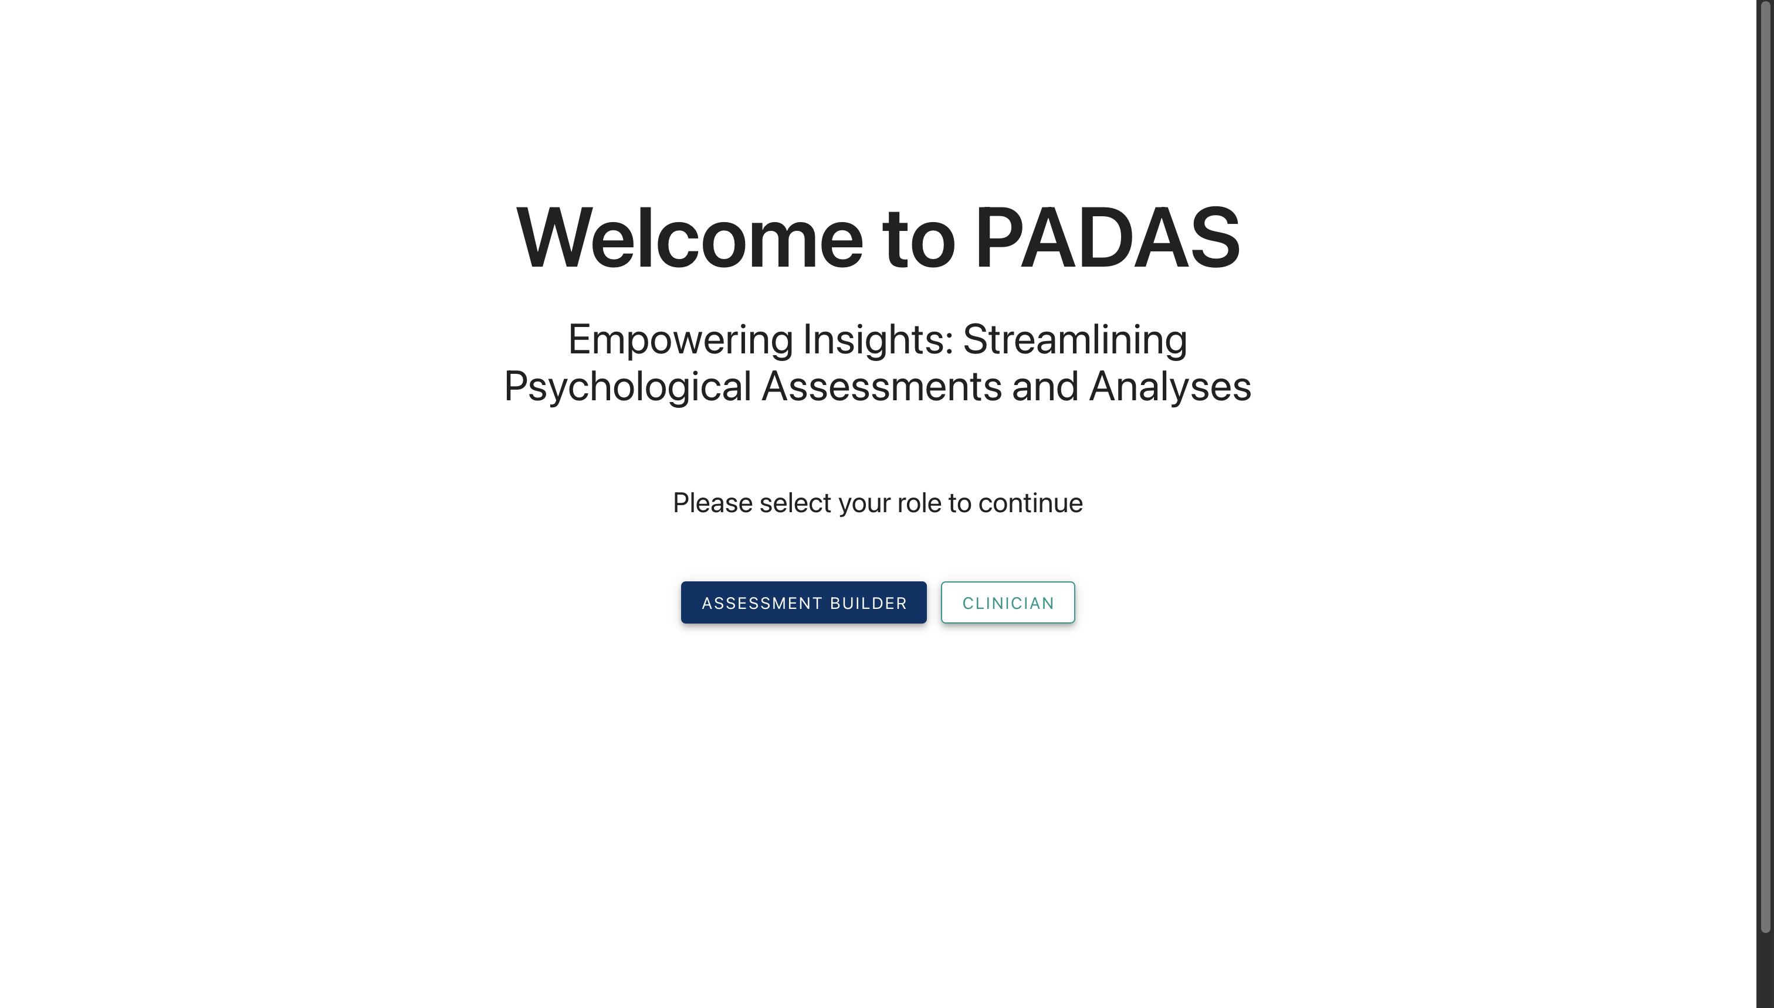
Splash Page
Splash Homepage where either the Assessment Builder or Clinicians can log in
User(s): Assessment Builder and Clinicians

Slide 12
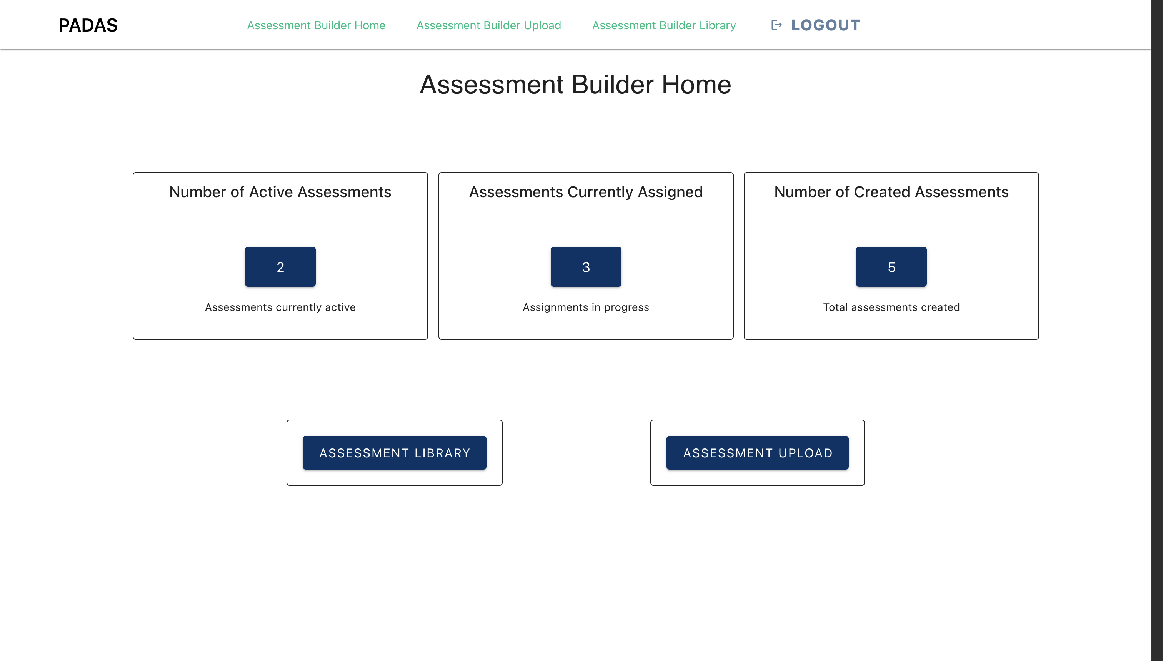
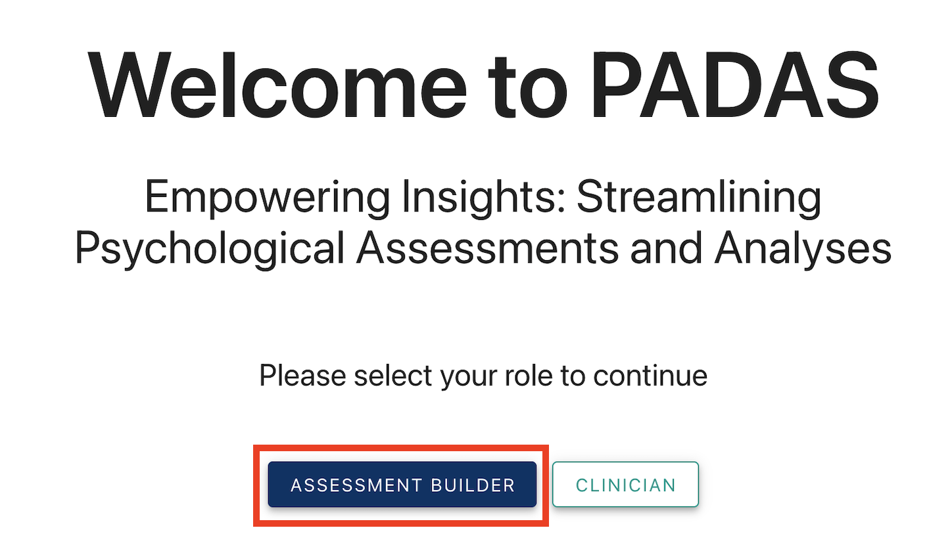
Assessment Builder Home
After logging in as an Assessment builder, user gets taken to the Assessment Homepage. From here, they can go to "Assessment Library" or "Assessment Upload".
User(s): Assessment Builder

Slide 13
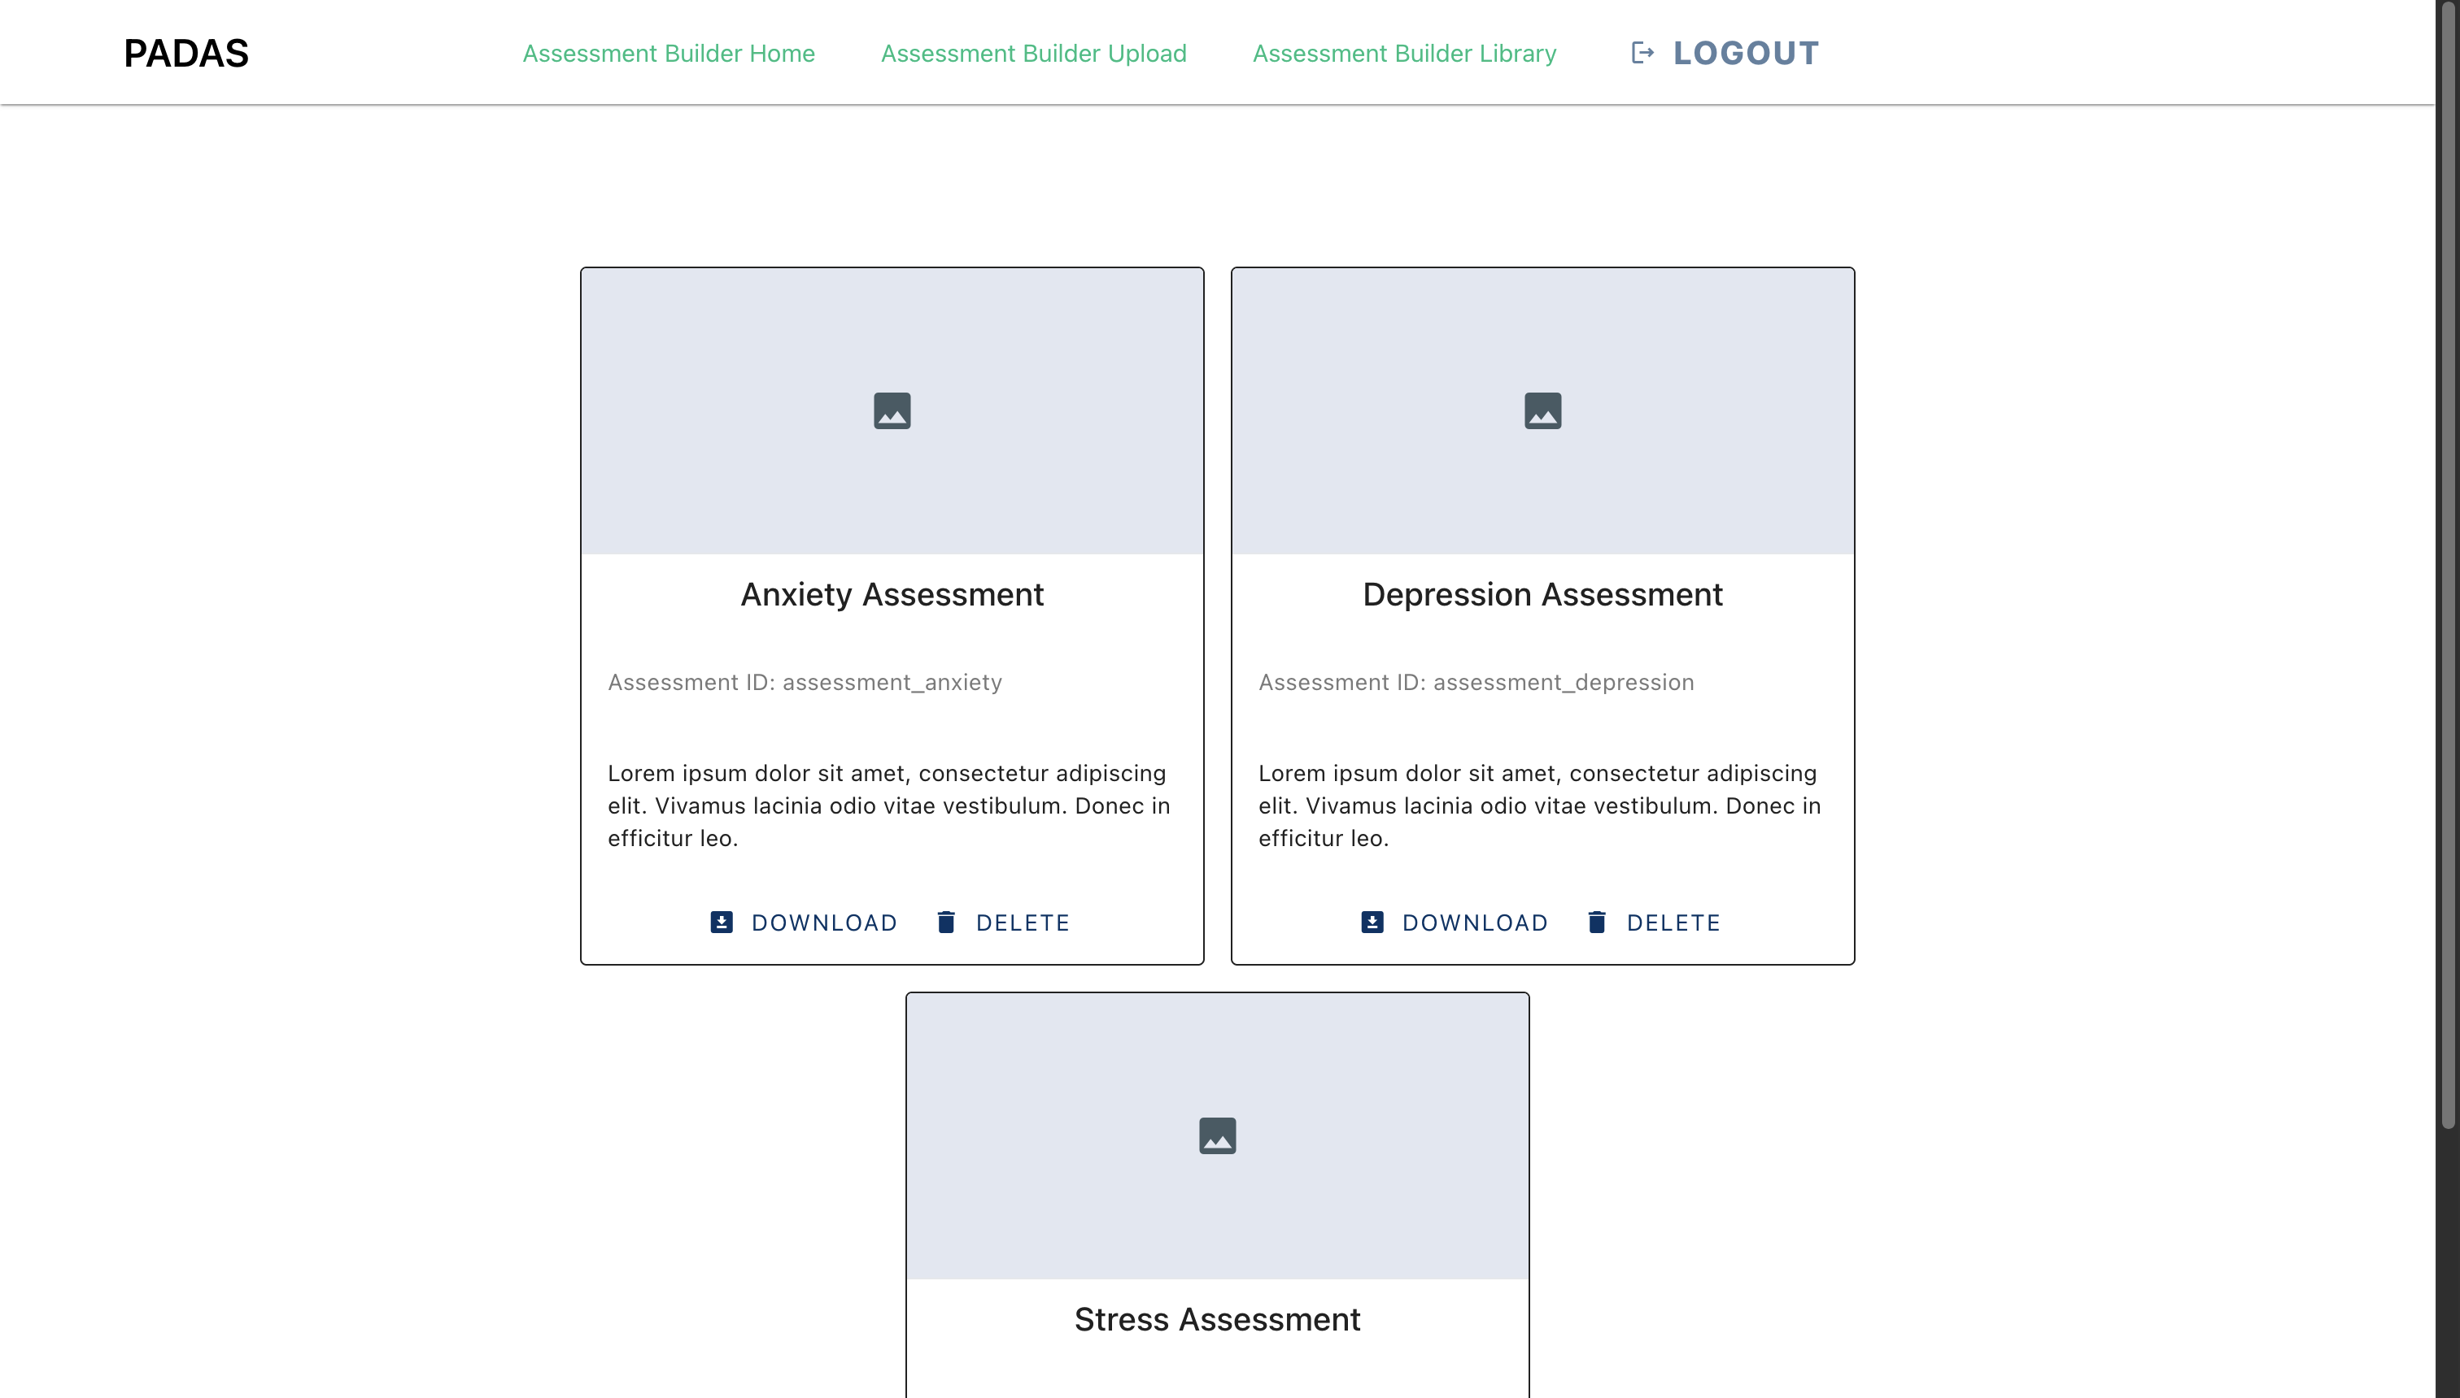
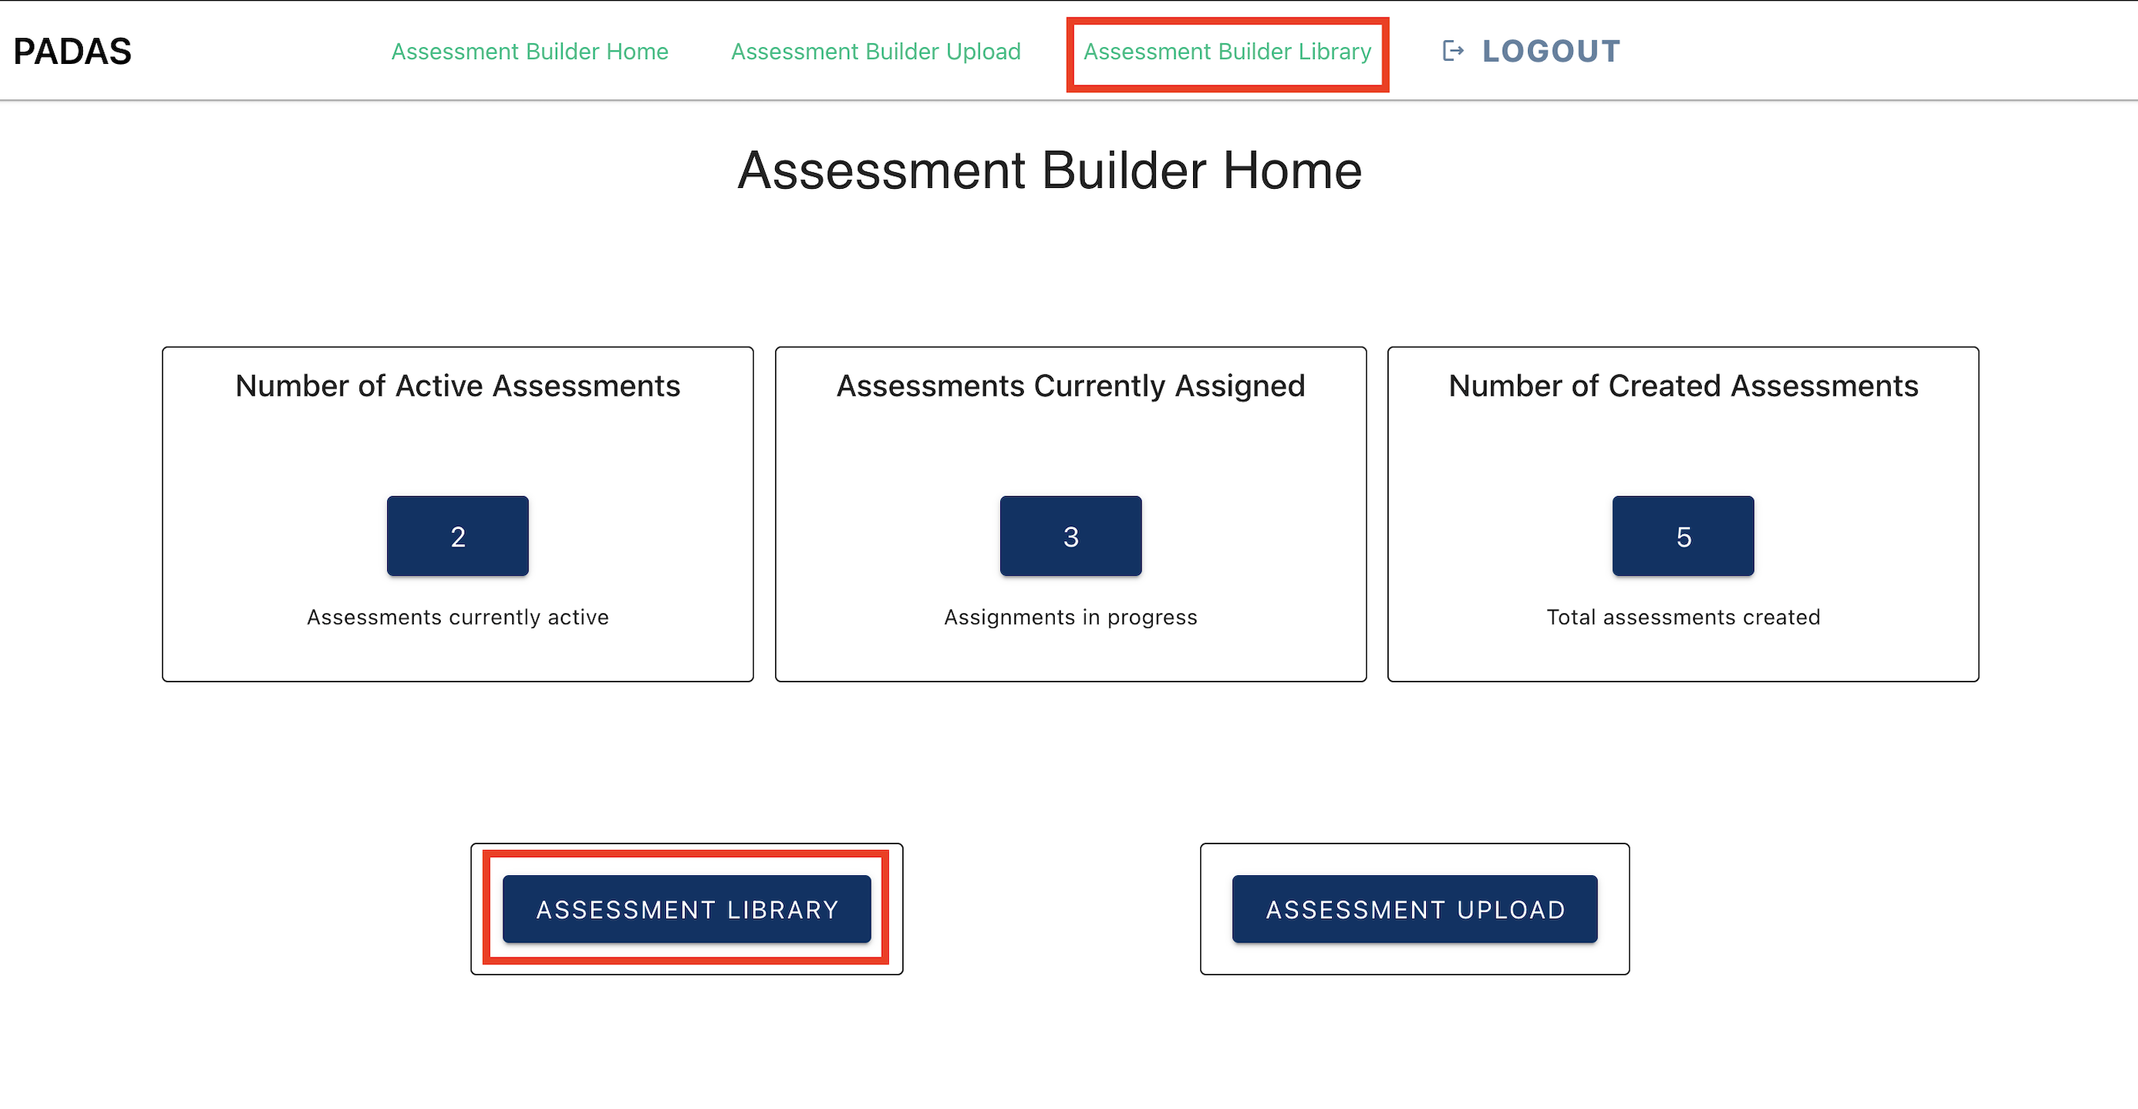
Assessment Builder Library
Here the user can view assessments that have already been uploaded. From here, the user can download the JSON file for a specific assessment or delete assessments.
User(s): Assessment Builder

Slide 14
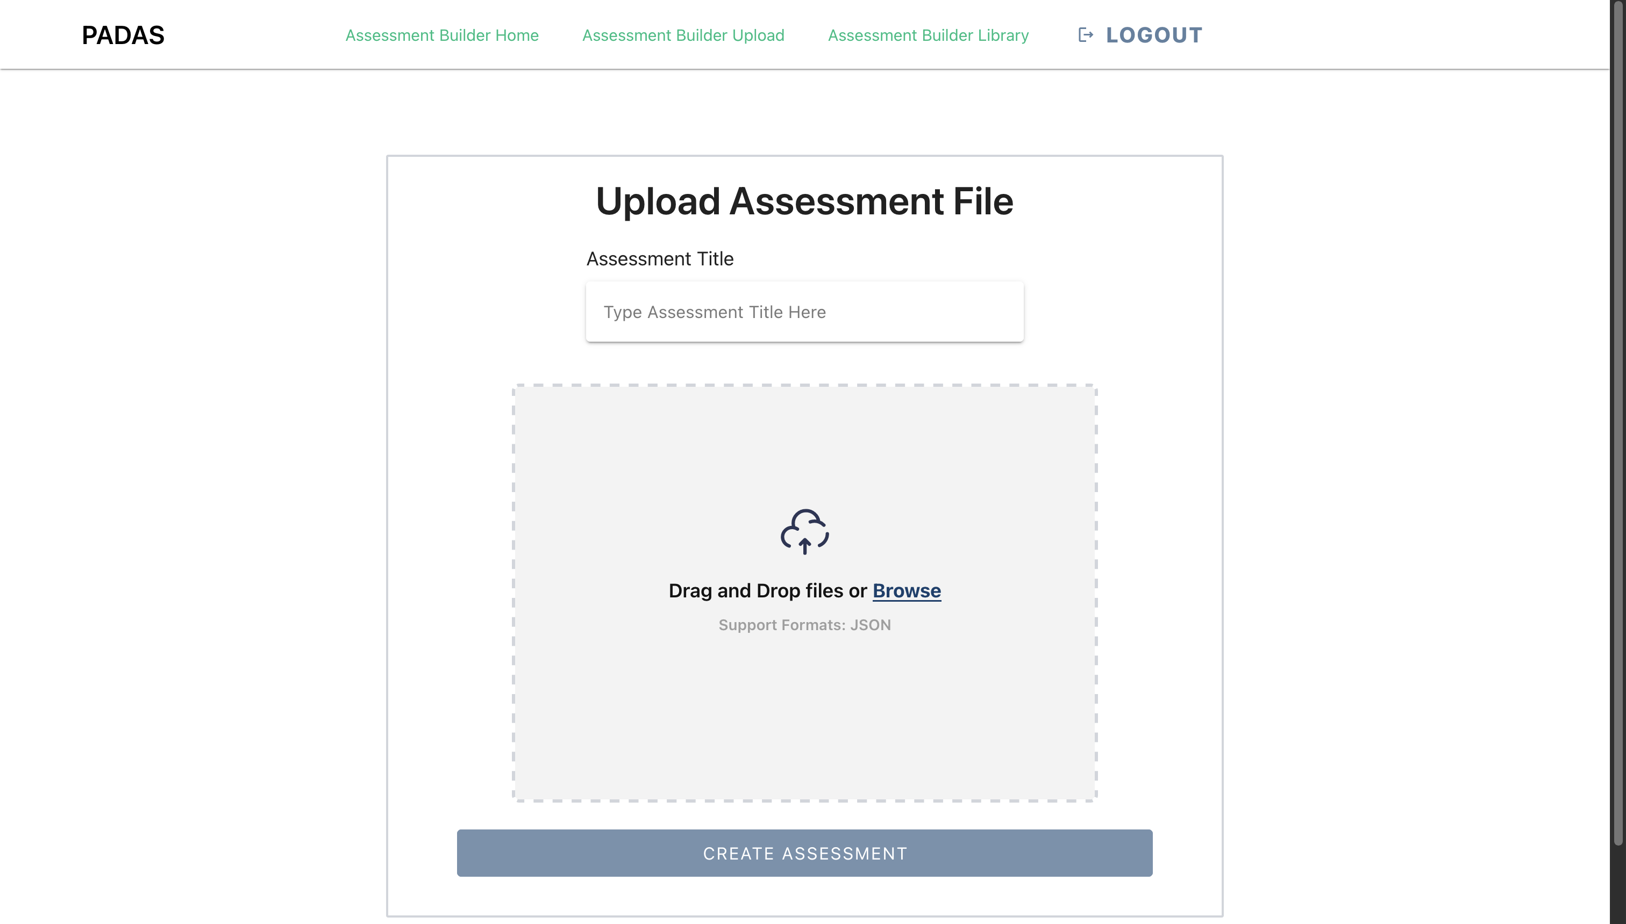
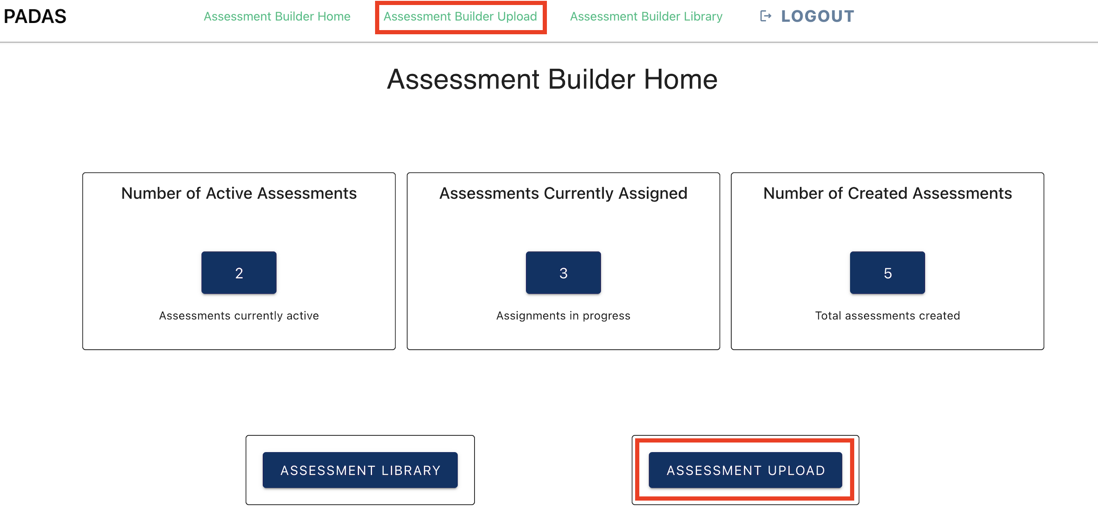
Assessment Builder Upload
This is where the user can upload custom assessments. The user uploads a JSON file outlining how the assessment will render.
User(s): Assessment Builder

Slide 15
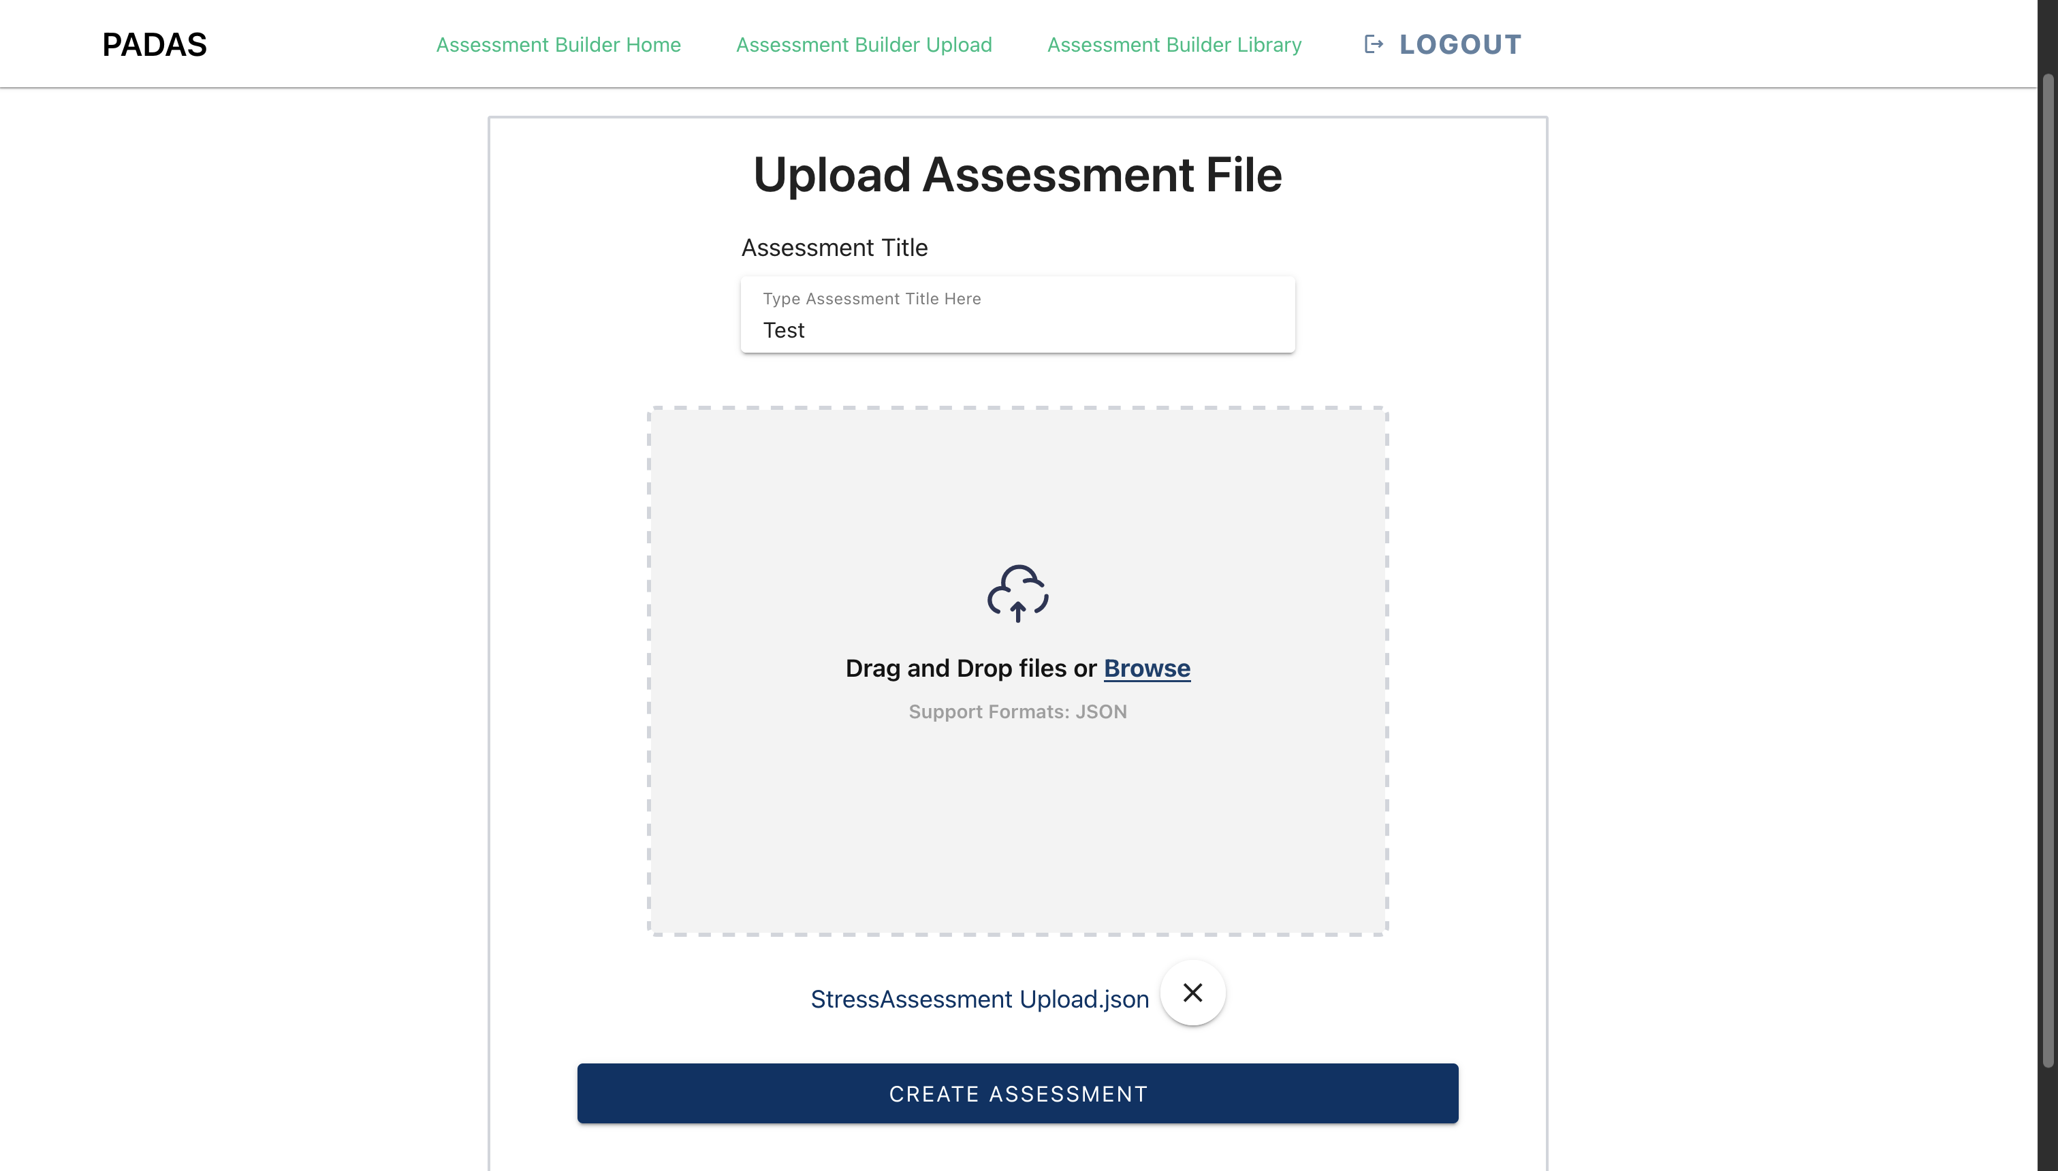
Assessment Upload Demo
When the user drag/drops or selects a valid file, the "Create Assessment" button is highlighted. The user then must name the assessment before adding it to the library.
User(s): Assessment Builder

Slide 16

Logout
The user can click the "Logout" button in the top right of the nav bar to return to the splash homepage.
User(s): Assessment Builder and Clinicians

Slide 17
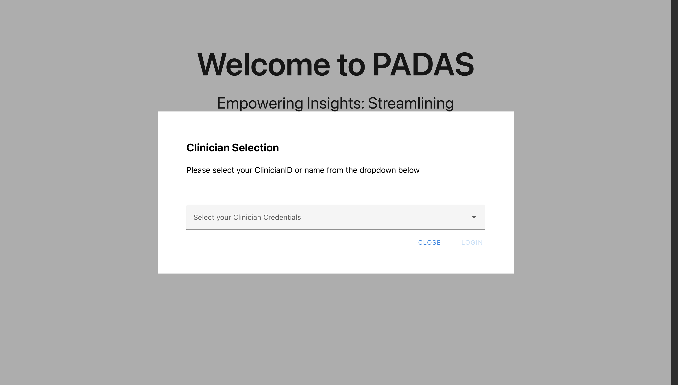
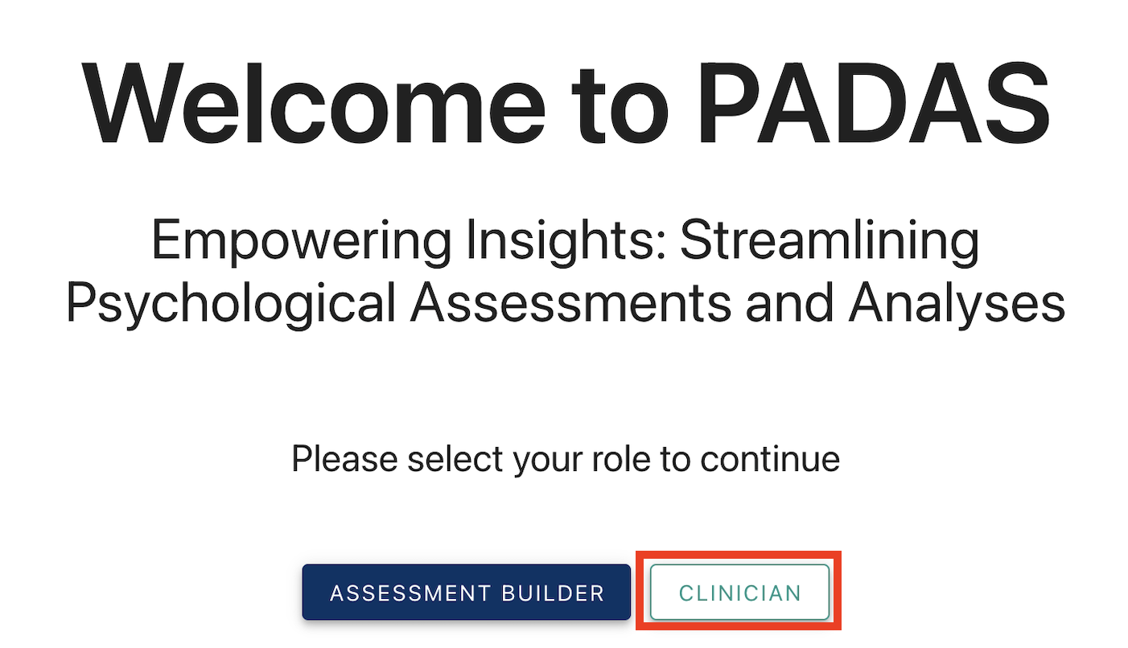
Clinician Login
When logging in as a Clinician, the user logs in using their credentials. These credentials are represented in a dropdown menu.
User(s): Clinicians

Slide 18
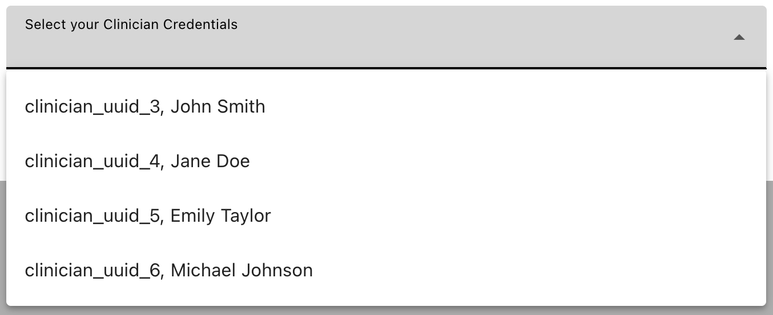
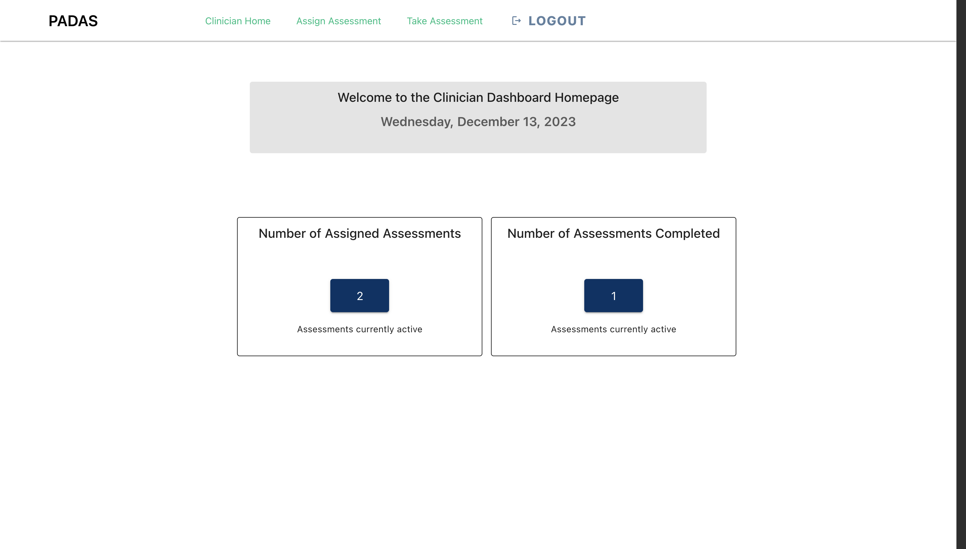
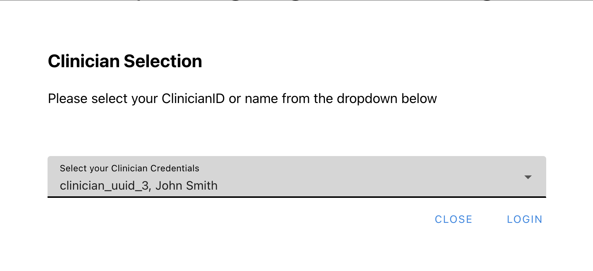
Clinician Homepage
After logging in as a Clinician, user gets taken to the Clinician Homepage. From here, they can go to "Assign Assessment" or "Take Assessment".
User(s): Clinicians

Slide 19
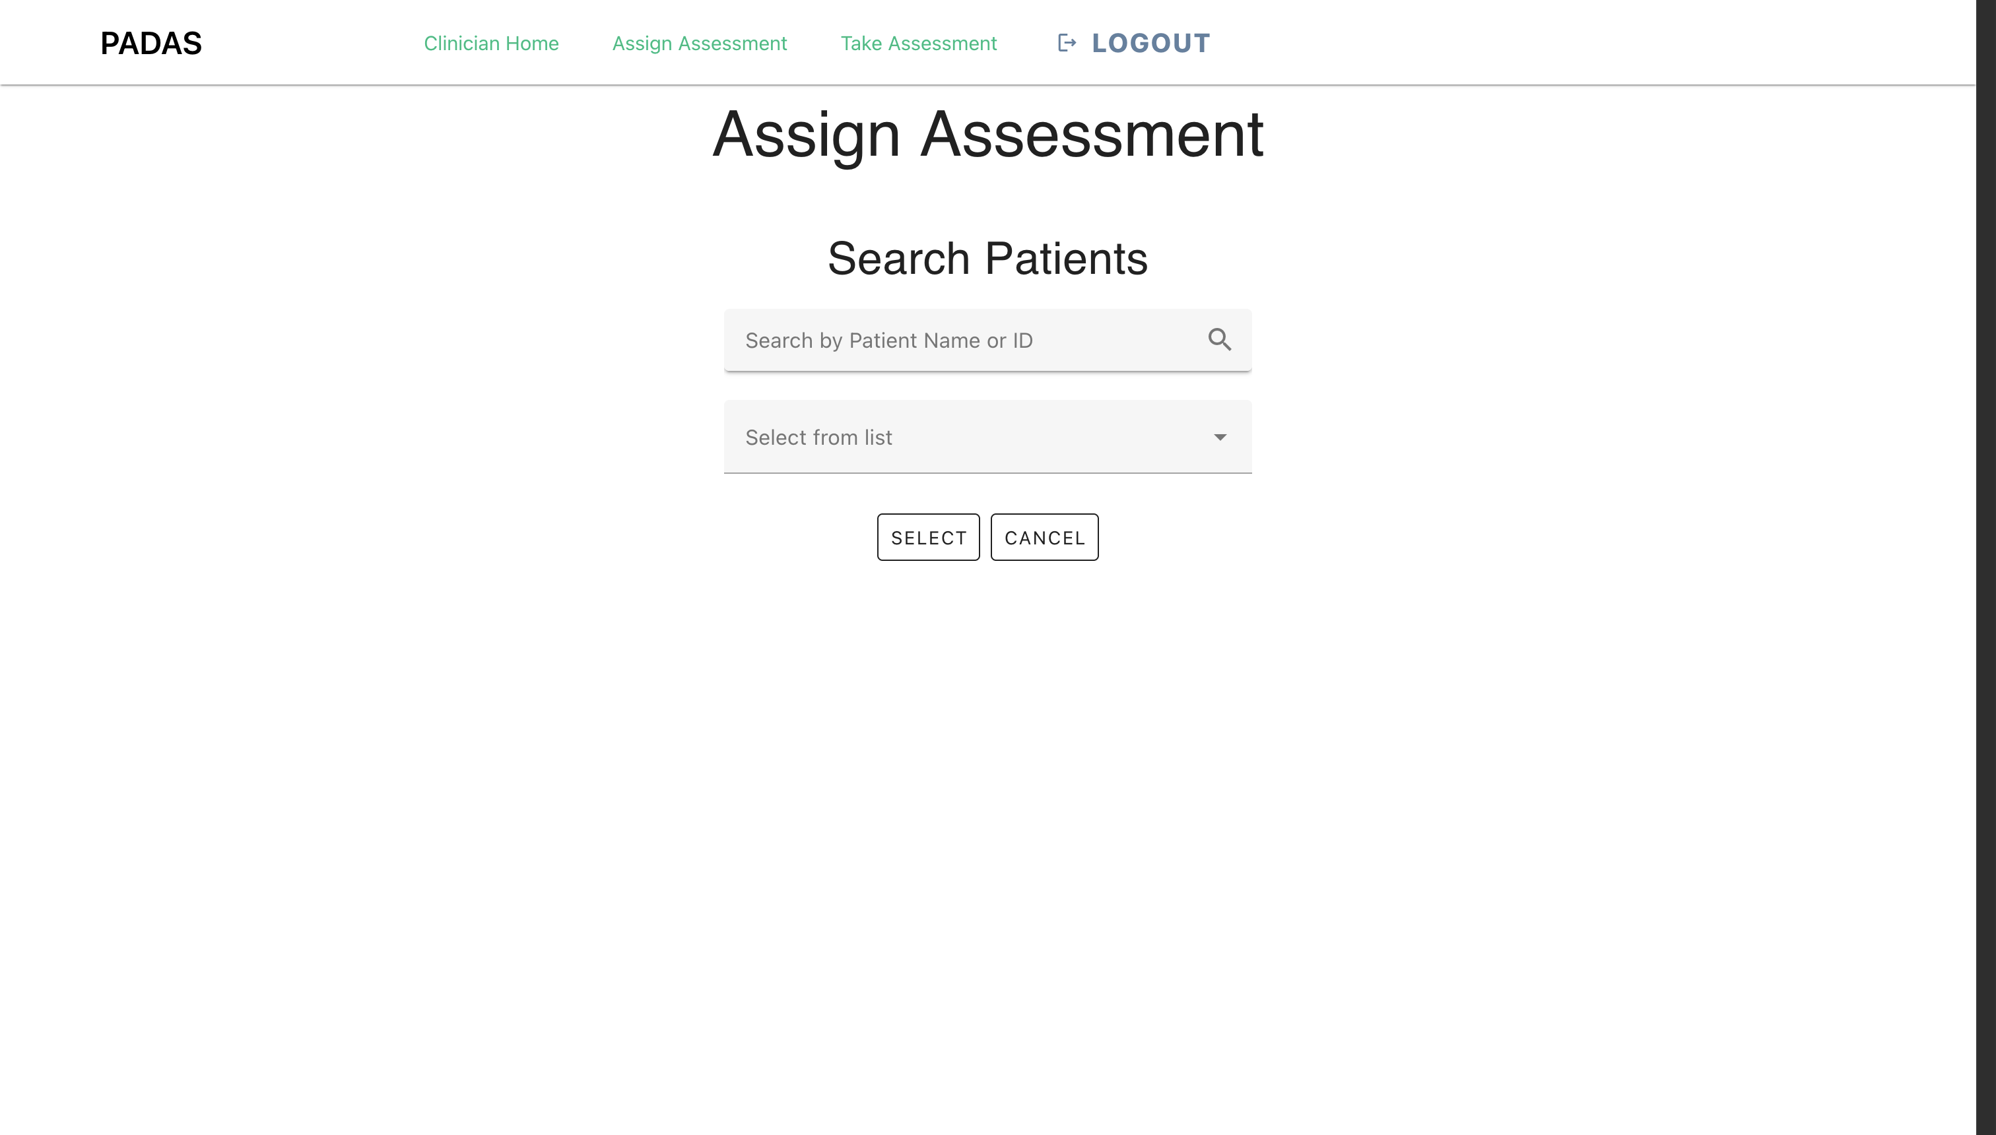
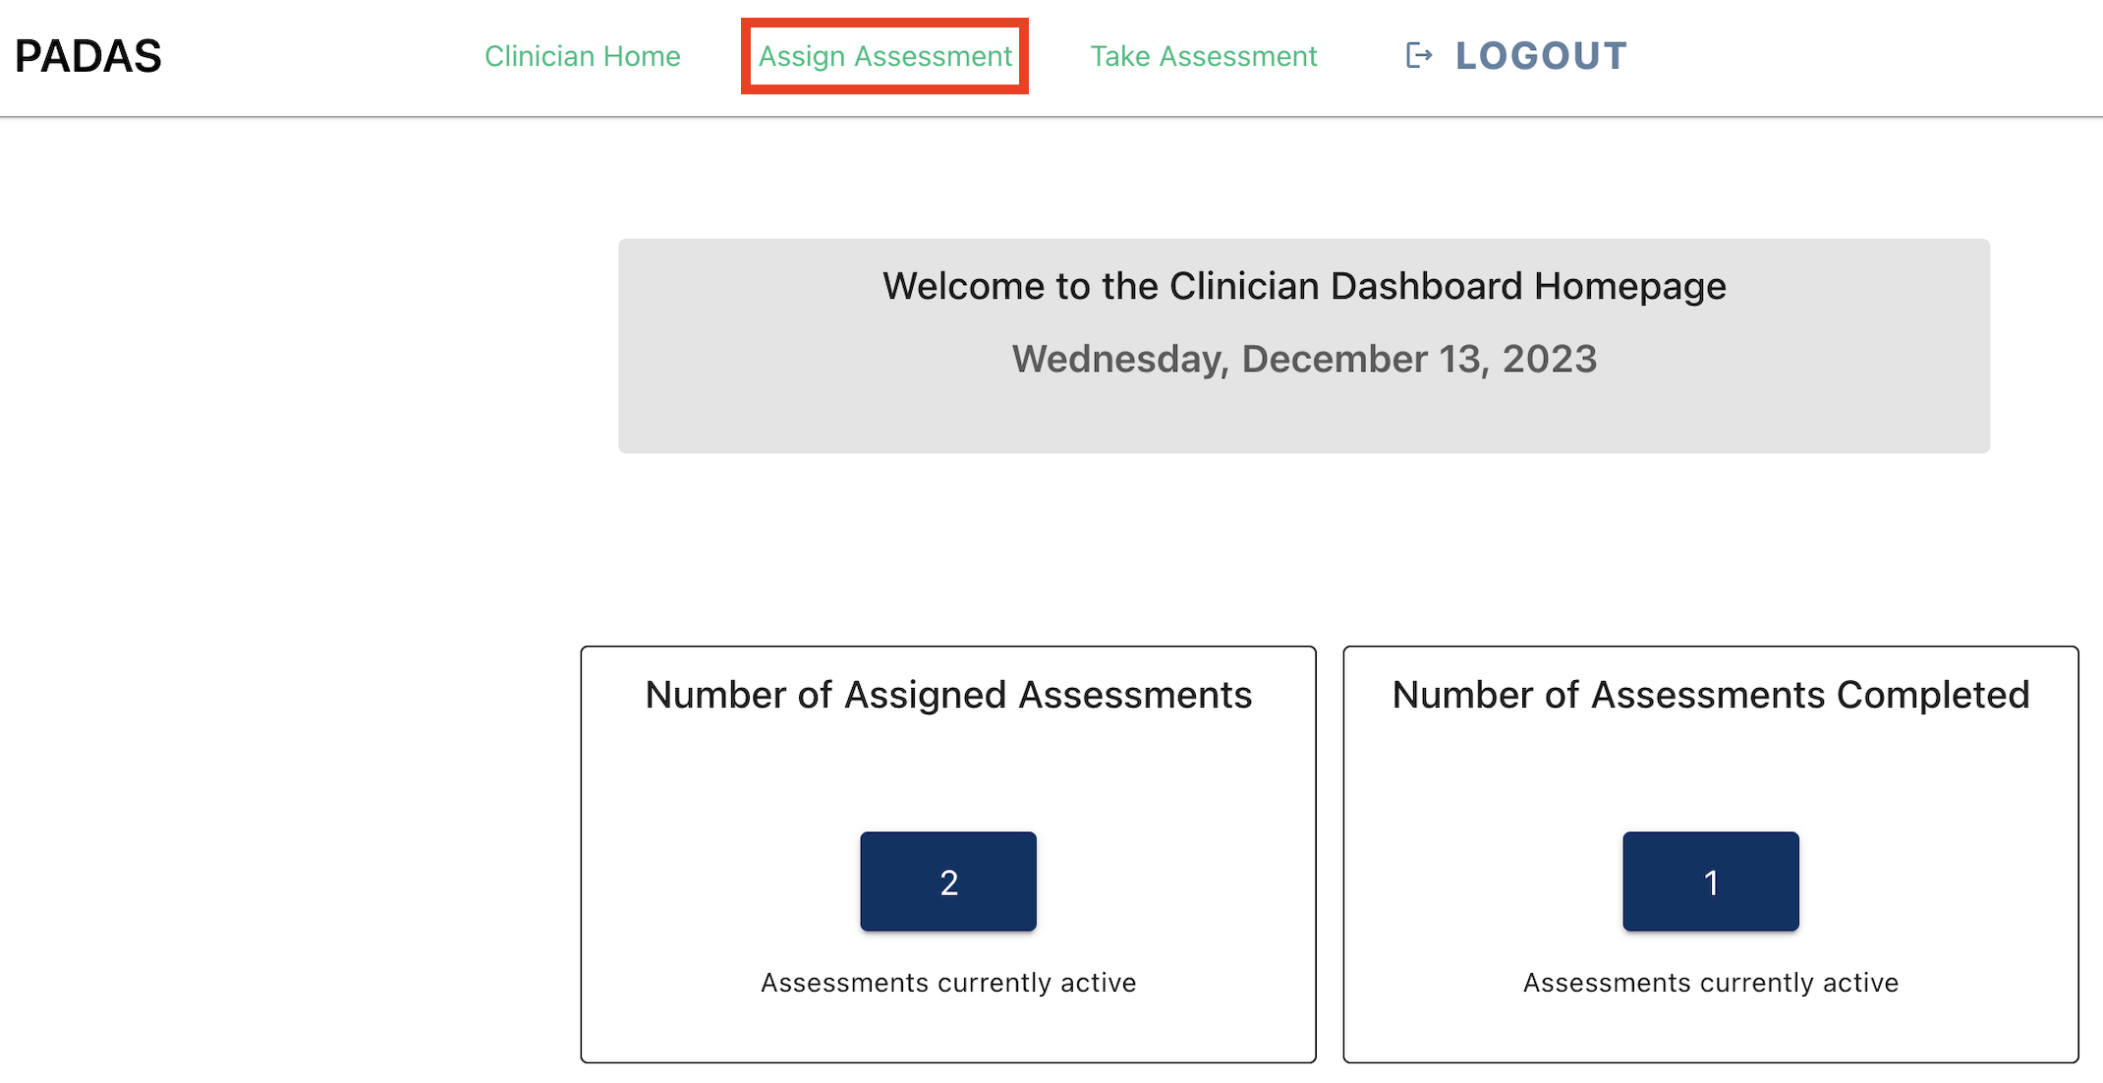
Assign Assessment: Patient
Here the user can assign an assessment to a patient. The user can search for the patient by search bar or by dropdown menu containing all their patients. "Select" confirms patient selection and moves on. "Cancel" returns to the clinician homepage.
User(s): Clinicians

Slide 20
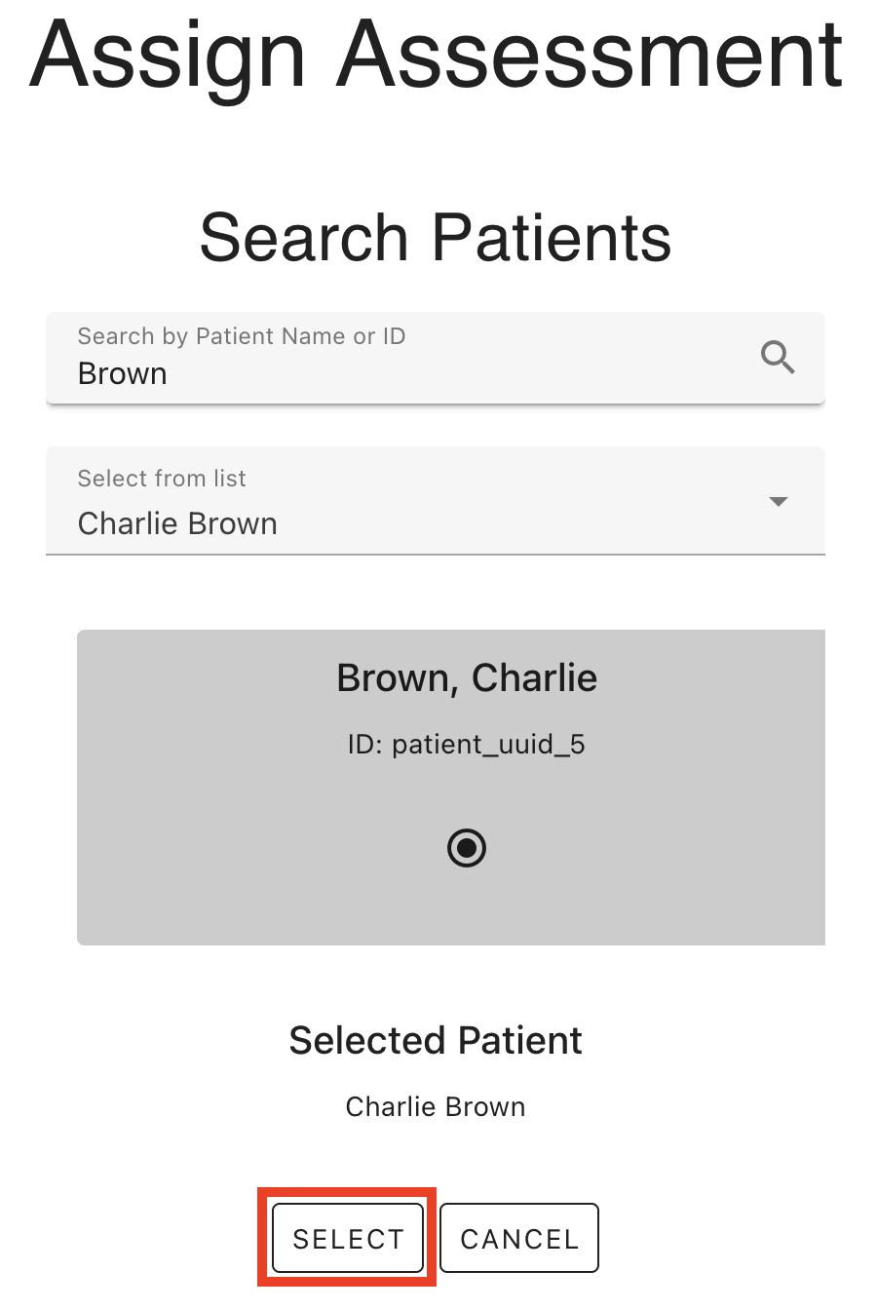

Assign Assessment: Assessment
After selecting a patient, the user can then move on to selecting the assessment they want to assign. The user can search via search bar or dropdown menu. "Select" moves on to confirm selections. "Back" returns to the patient selection/search.
User(s): Clinicians

Slide 21
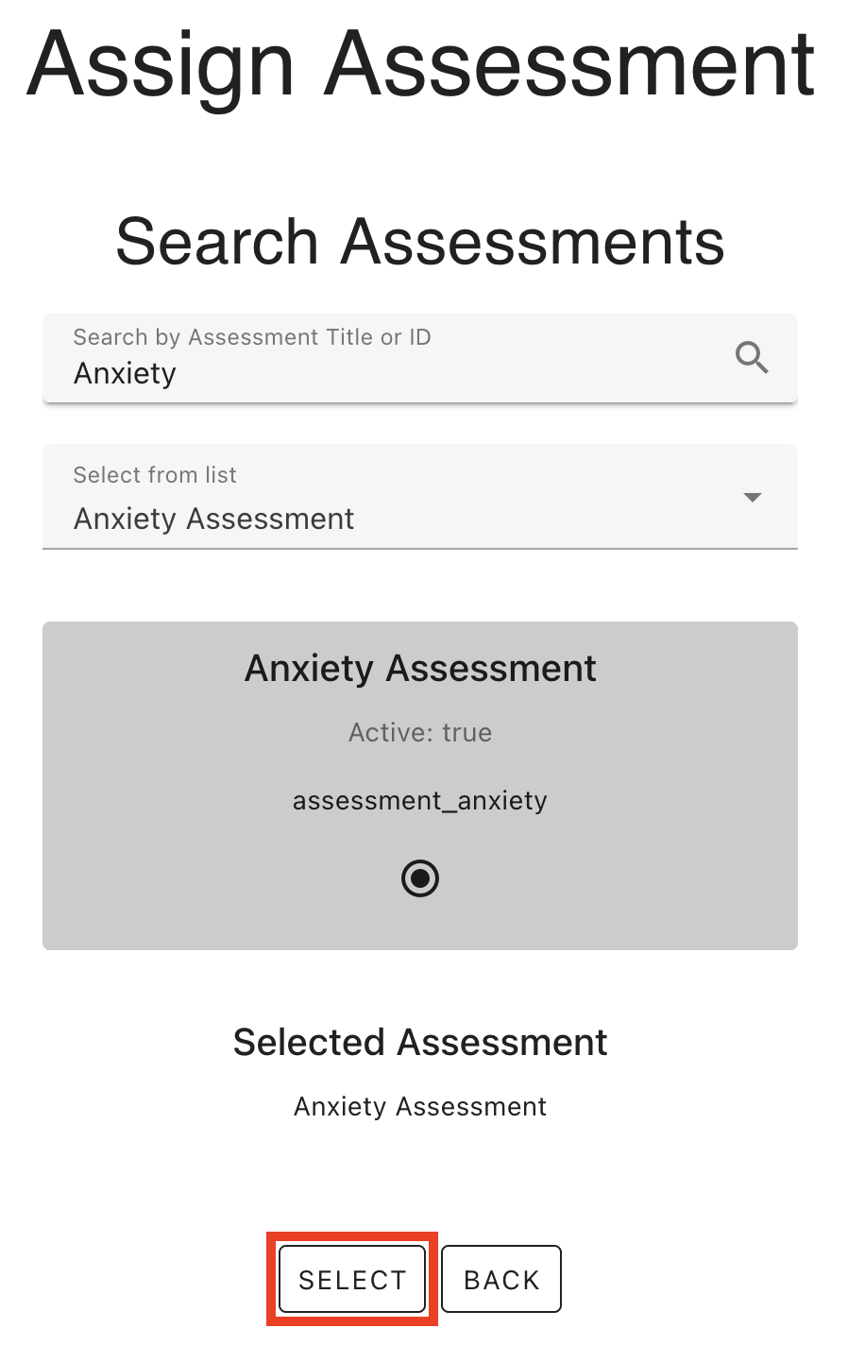
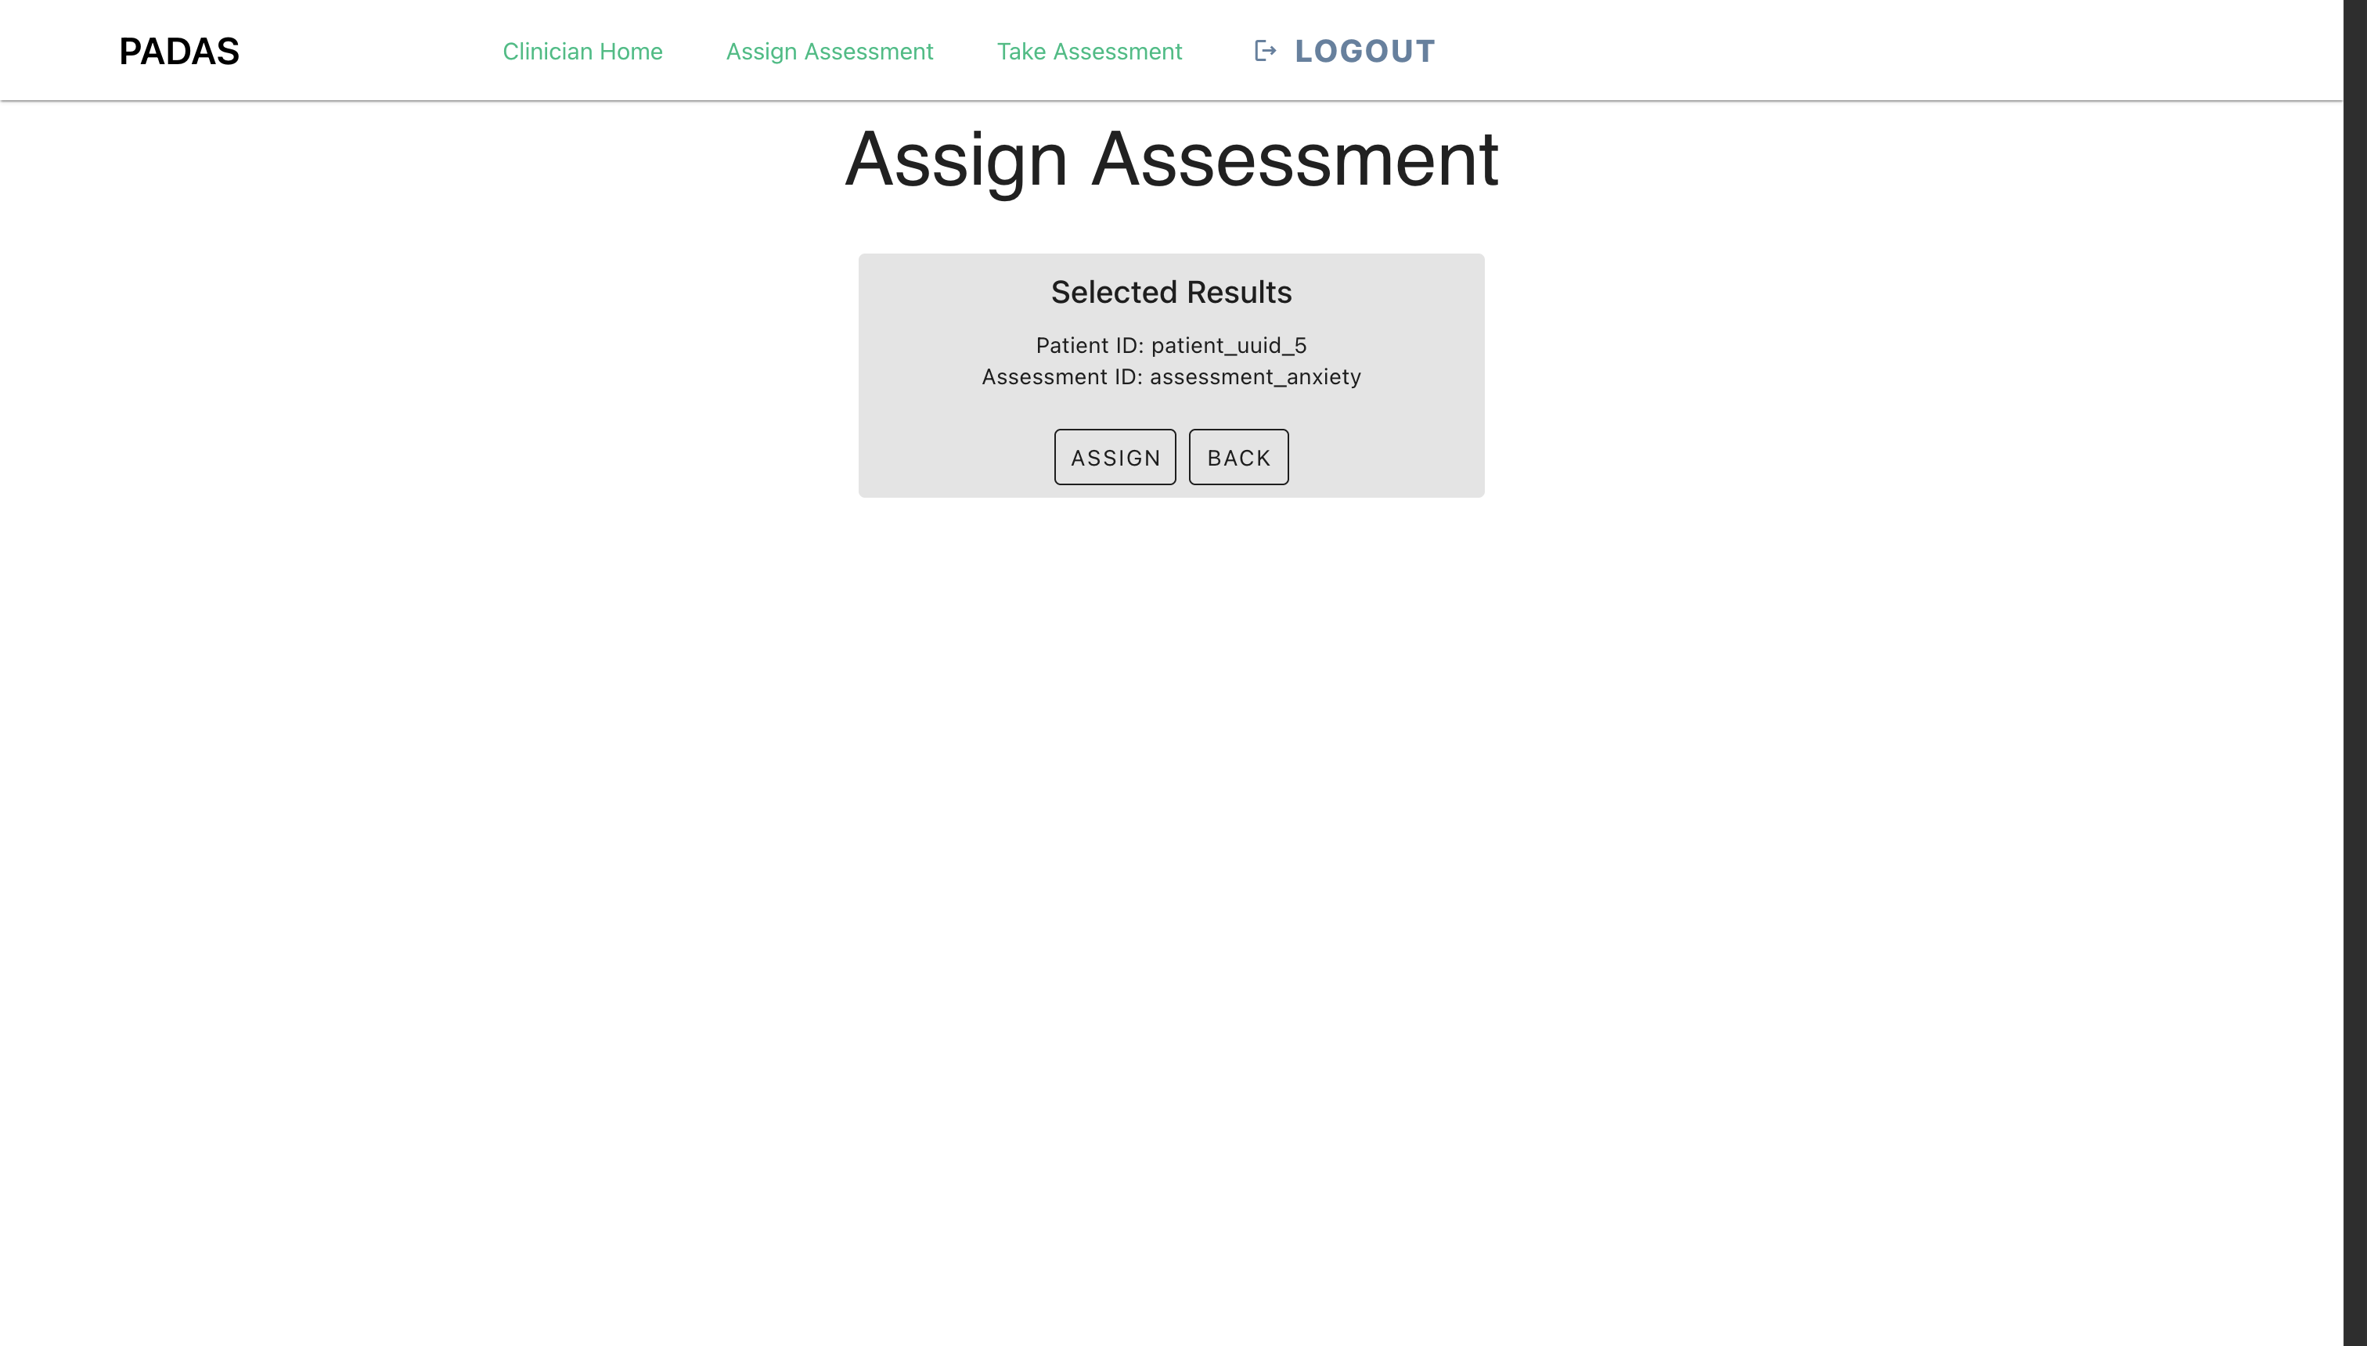
Assign Assessment: Confirmation
After selecting an assessment, the user is taken to a confirmation page to confirm the assignment. "Assign" will assign the selected assessment to the selected patient. "Back" will take the user back to the Assessment Selection.
User(s): Clinicians

Slide 22
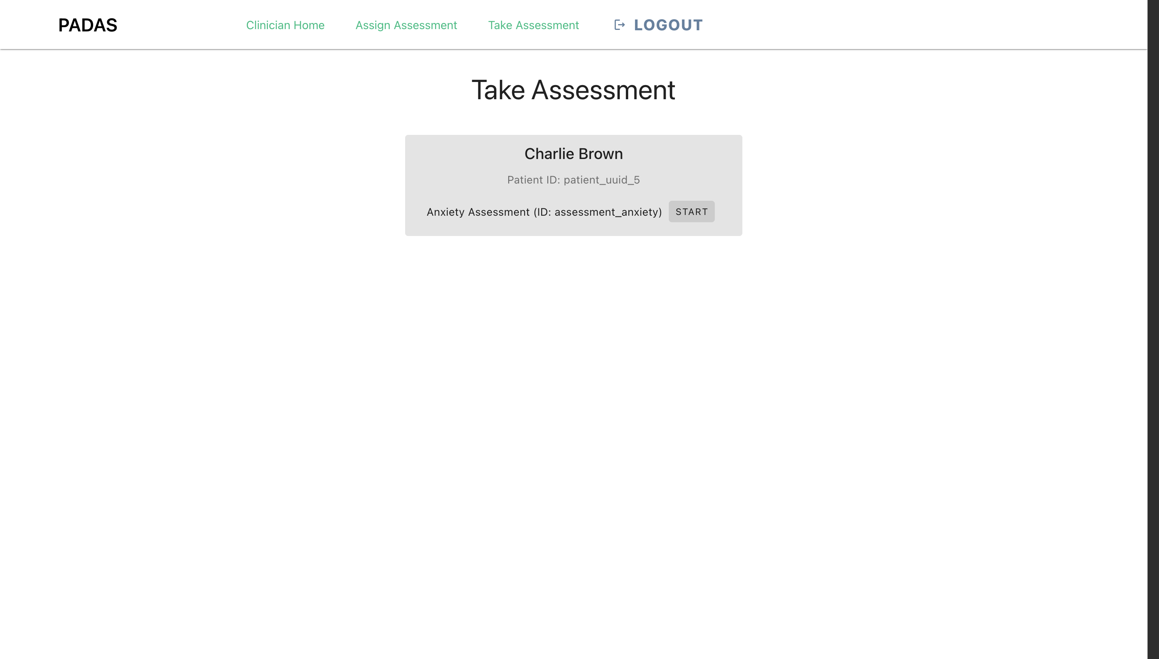
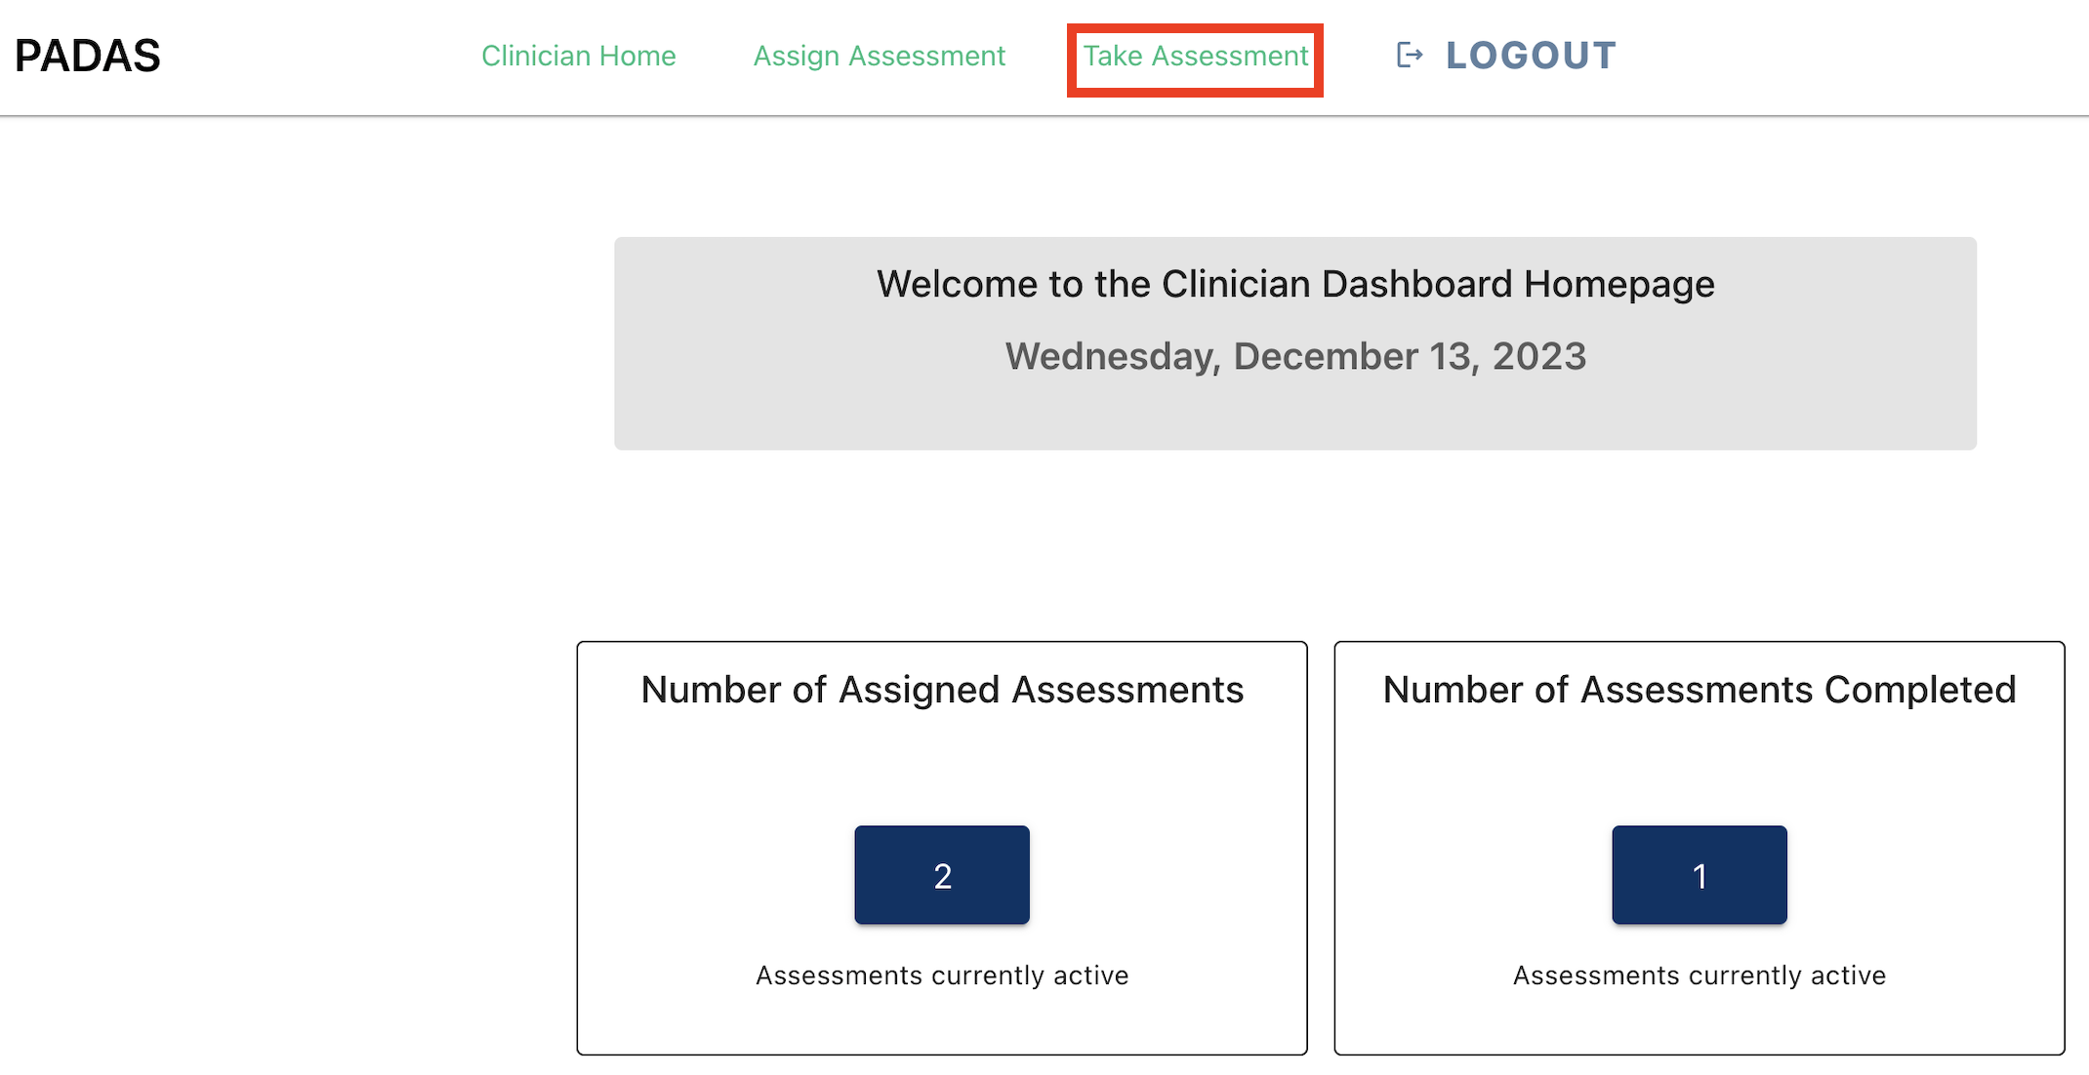
Take Assessment: View
Here the user can view what assessments are assigned to what patient. From here, the user can select "Start" next to an assigned assessment to render it, and hand the device over to the patient for them to begin the assessment.
User(s): Clinicians

Slide 23
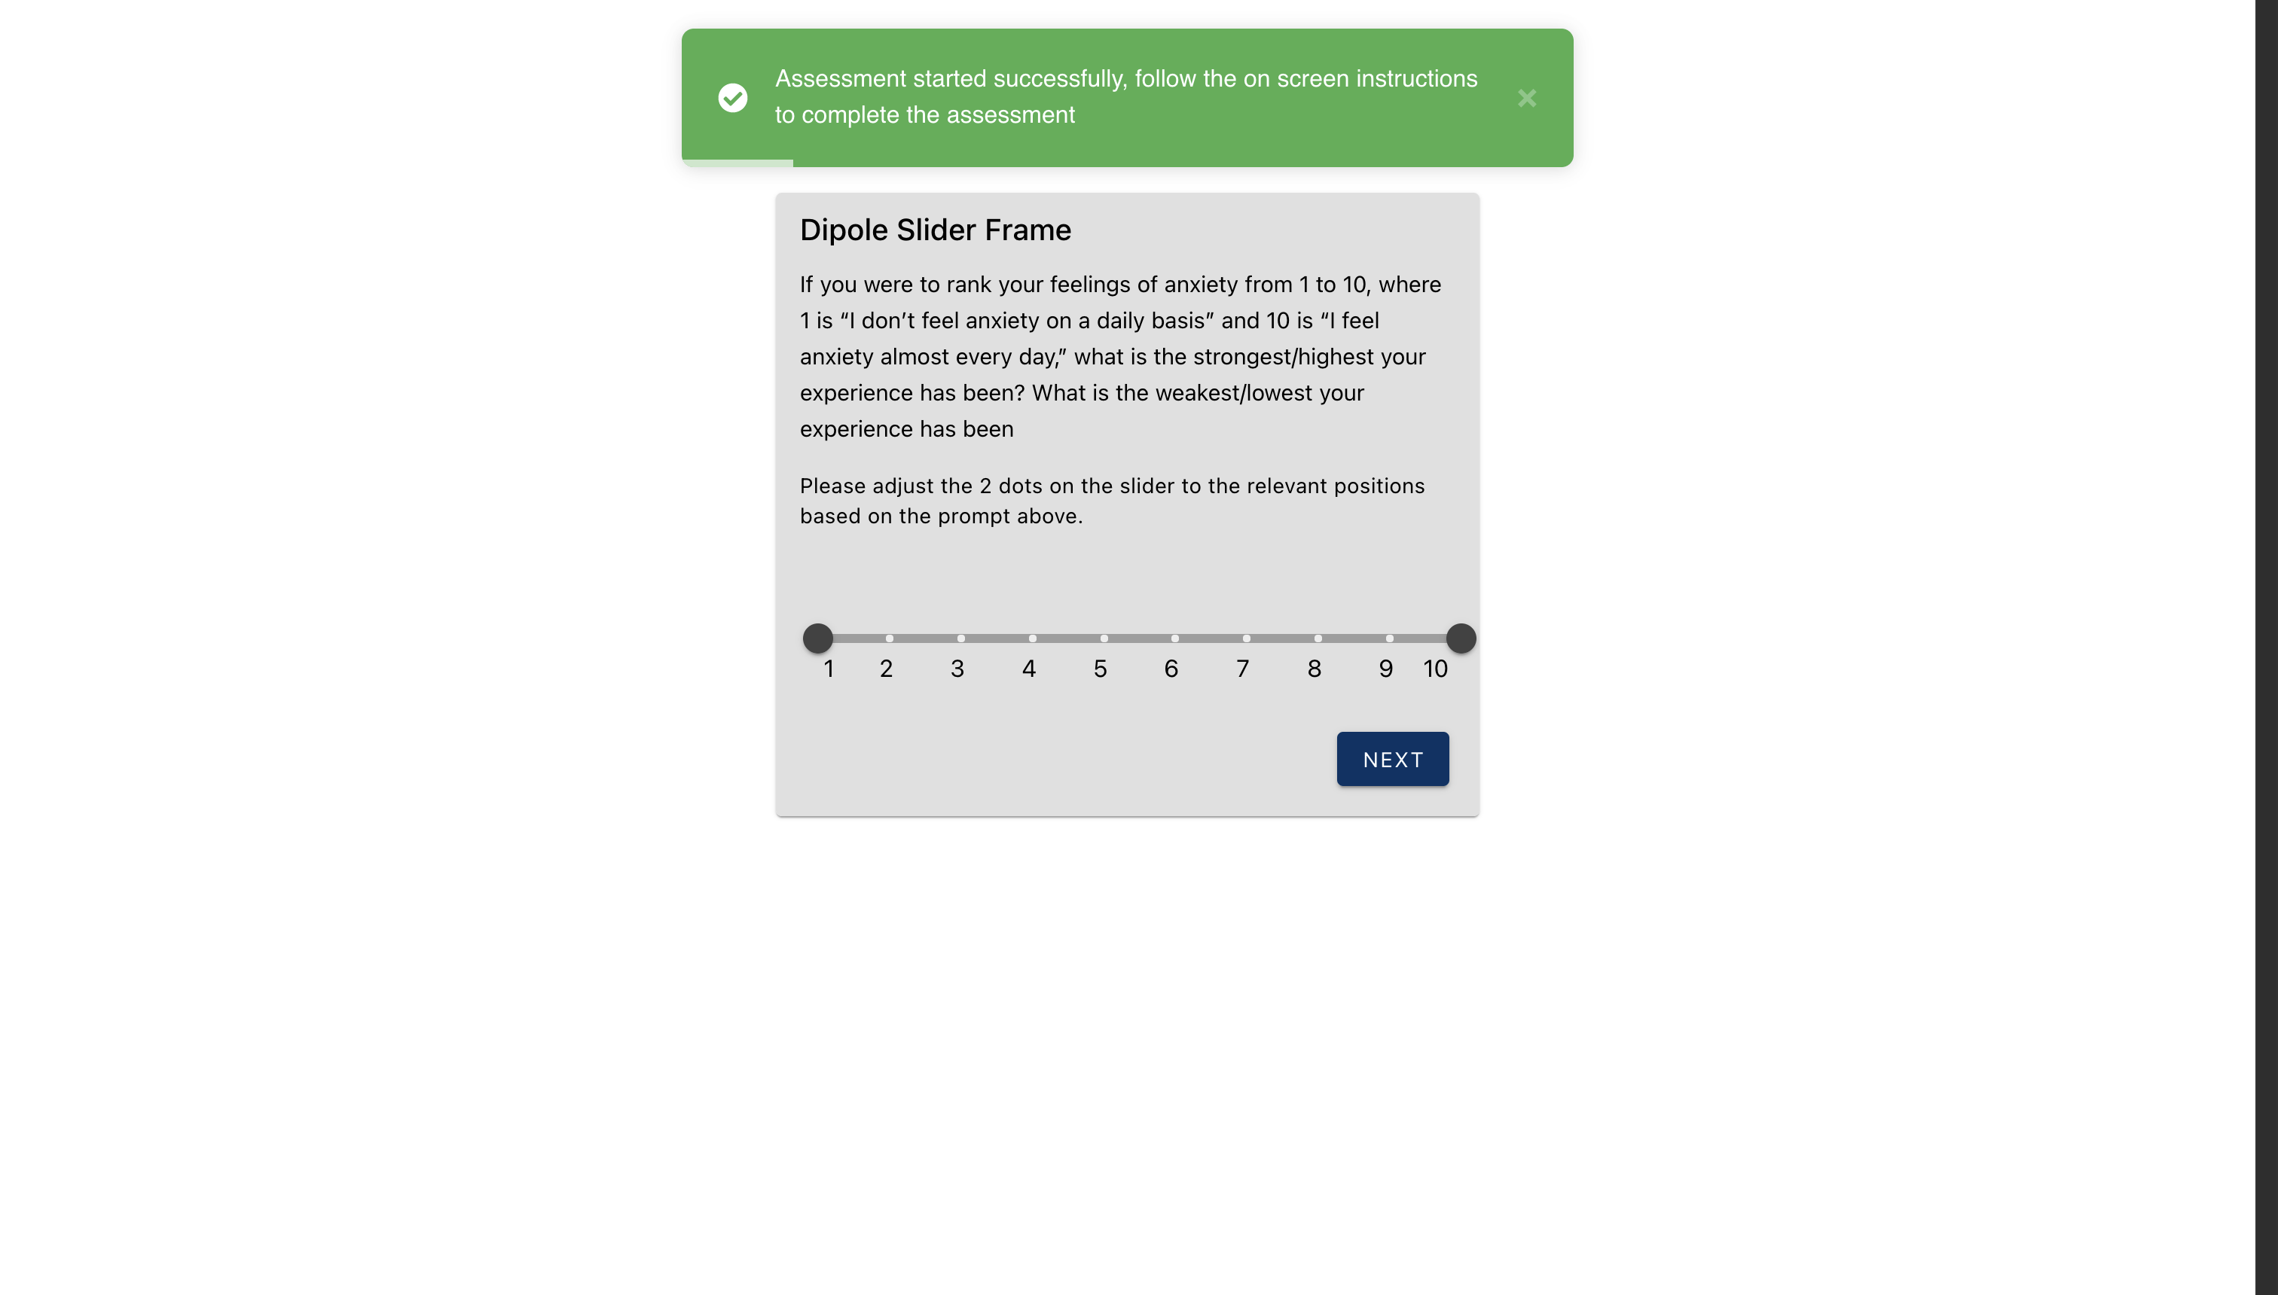
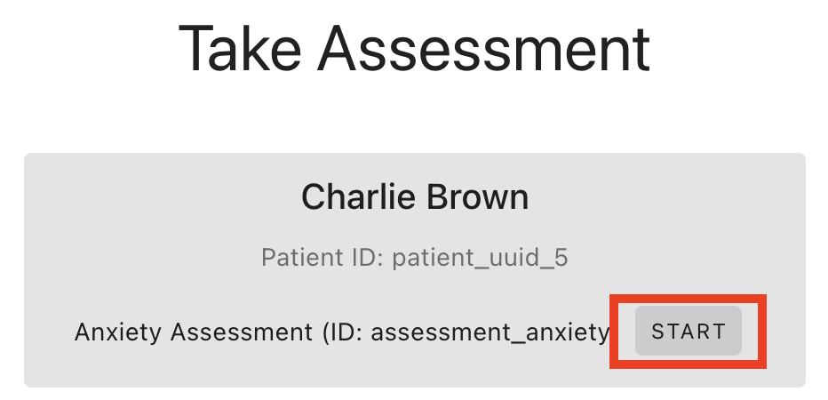
Take Assessment: Assessment
The patient begins taking the survey one question at a time after being handed the device by their clinician.
User(s): Patients

Slide 24
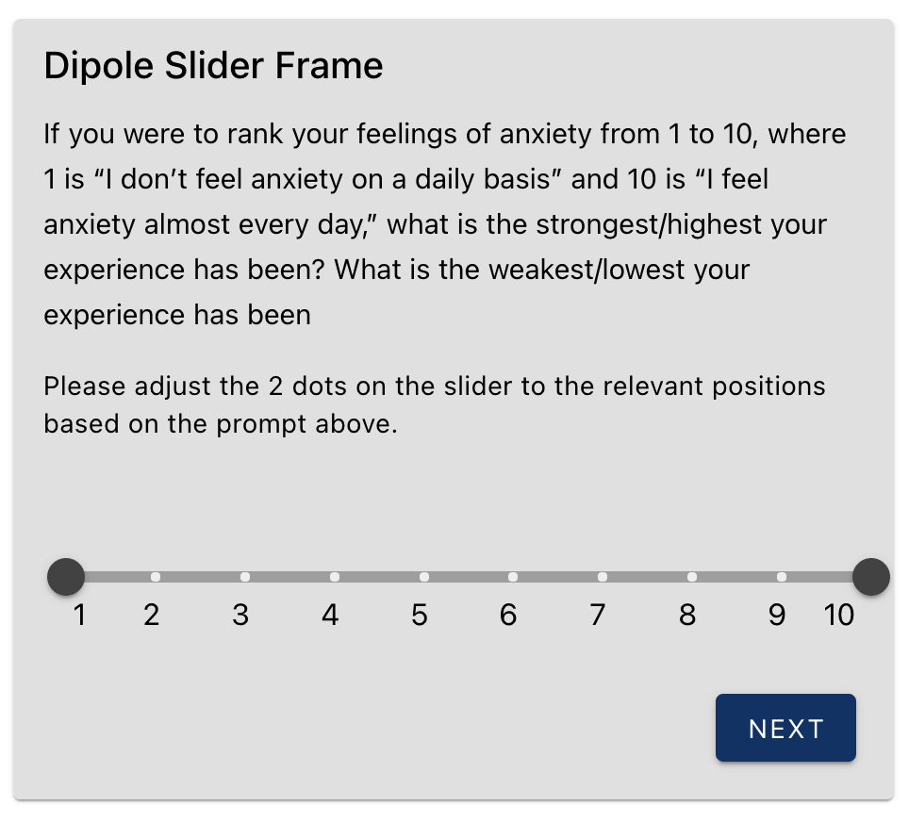
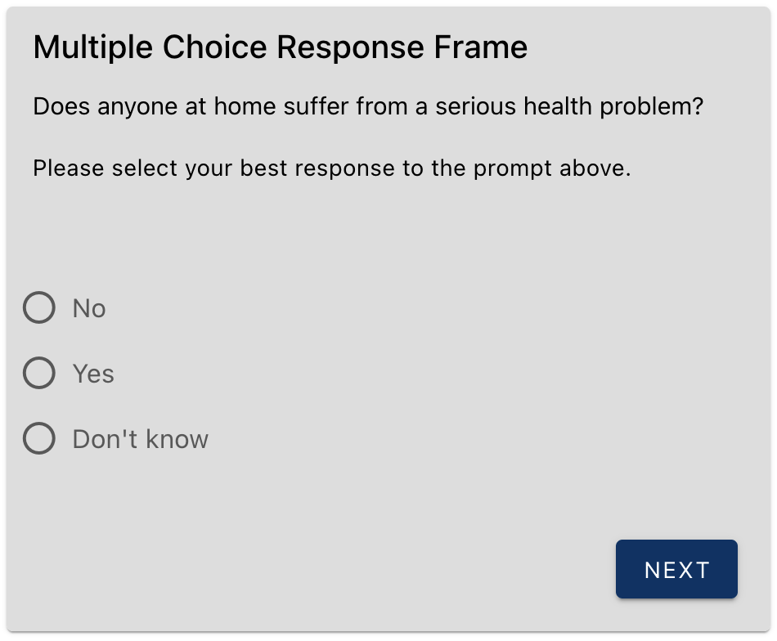
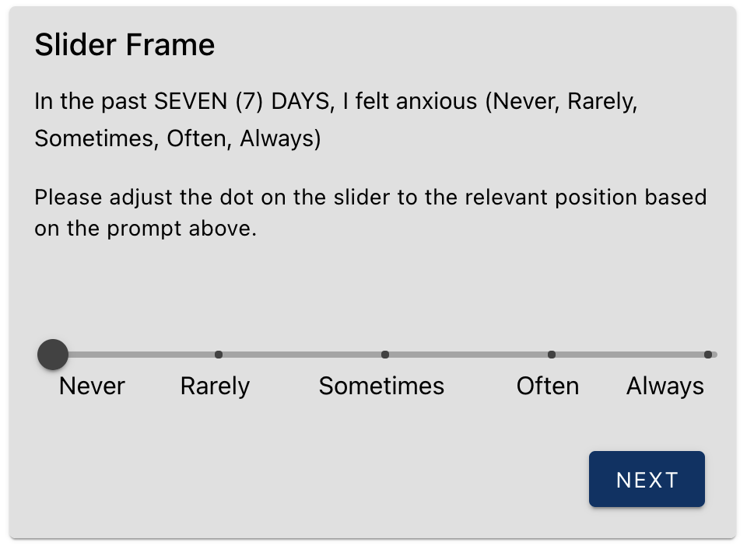
Take Assessment: Question examples
The patient can have different types of questions in their assessment: Dipole Slider, Slider, Multiple choice, Checkboxes, Textbox, Image Selection, Response Button. Pictured above is three examples from the Anxiety Assessment.
User(s): Patients

Slide 25
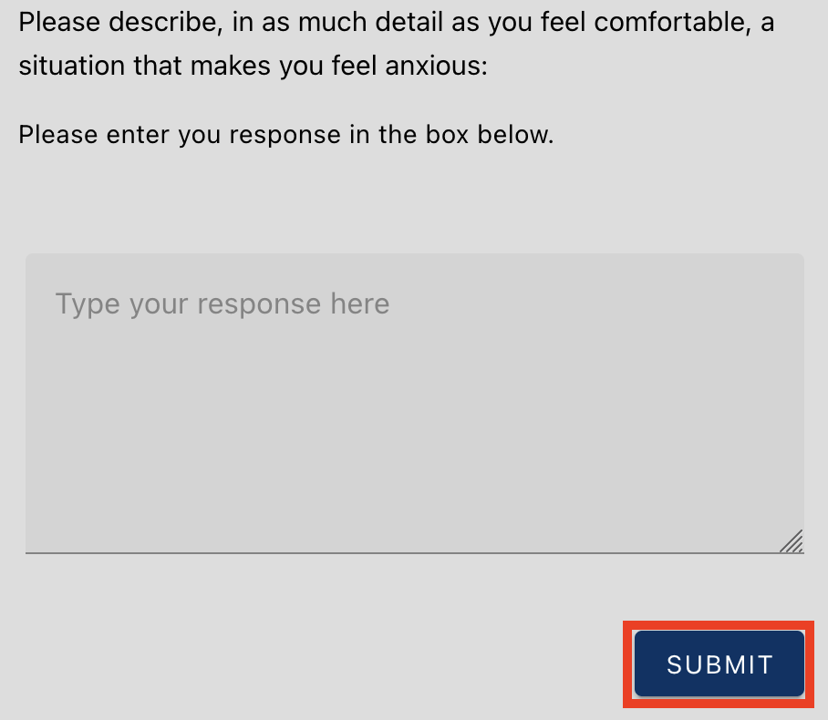
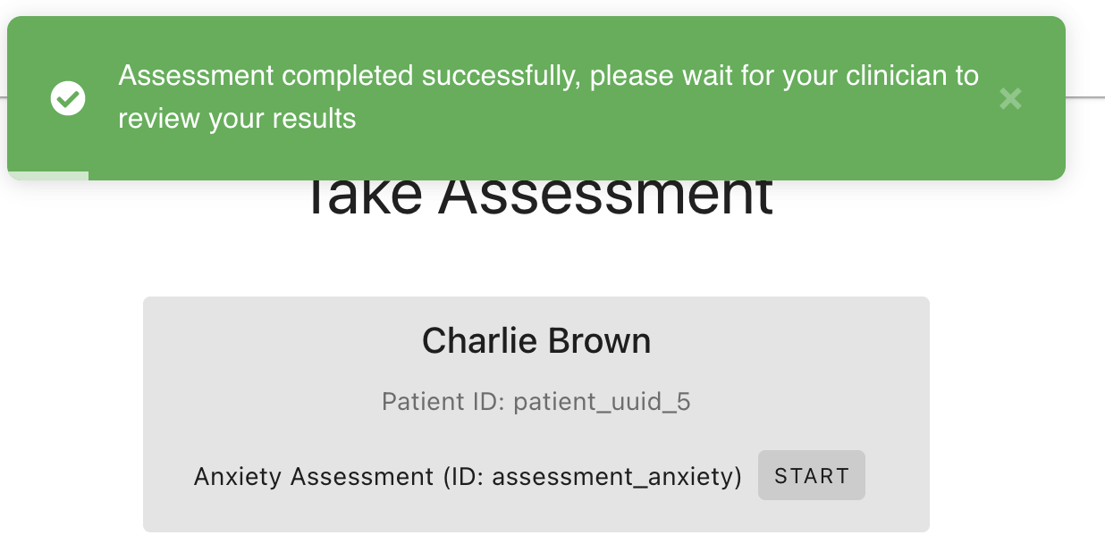
Take Assessment: Completion
The last question in the assessment ends with "Submit". Once this is clicked, the assessment is completed, and the device is handed back to the clinician.
User(s): Patients then Clinicians

